Slide 1

The
Seventh-day Adventist
South Philippine Union Conference

Slide 2
PRESENTS

Slide 3

ADVENTIST WORLD INTERNET RADIO
ADVENTIST WORLD INTERNET RADIO
Notes:
WORLD ADVENTIST INTERNET RADIO

Slide 4



THE
CONCEPT
3ABN
YMVC
Three Angels Broadcasting Network
YOUTH MEDIA VOLUNTERS CLUB

Slide 5
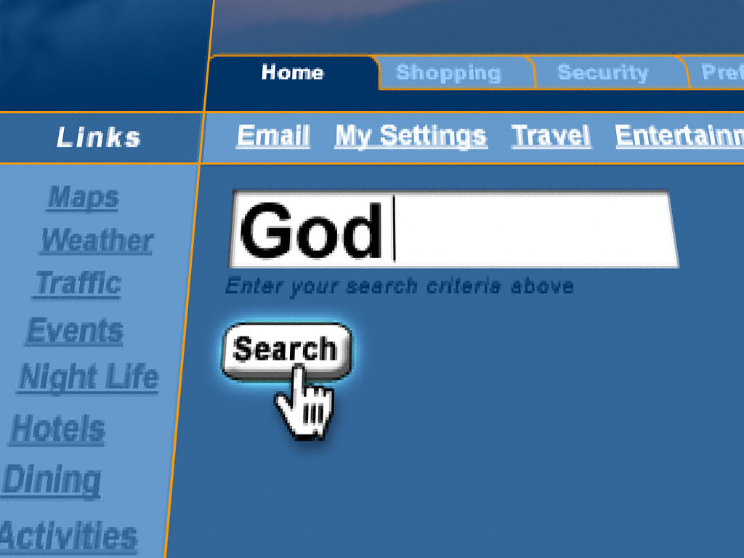
WHY INTERNET EVAGELISM ?

Slide 6

Mark 16:15 – “Go ye into all the world and preach the gospel to every creature.”
Matthew 24:14 – “And this gospel of the kingdom shall be preached in all the world as a witness unto all nations; and them shall the end come.
Acts 1:8 – “ …and ye shall be witnesses unto me both in Jerusalem and in all Judea and in Samaria and unto the uttermost part of the world.”

Slide 7
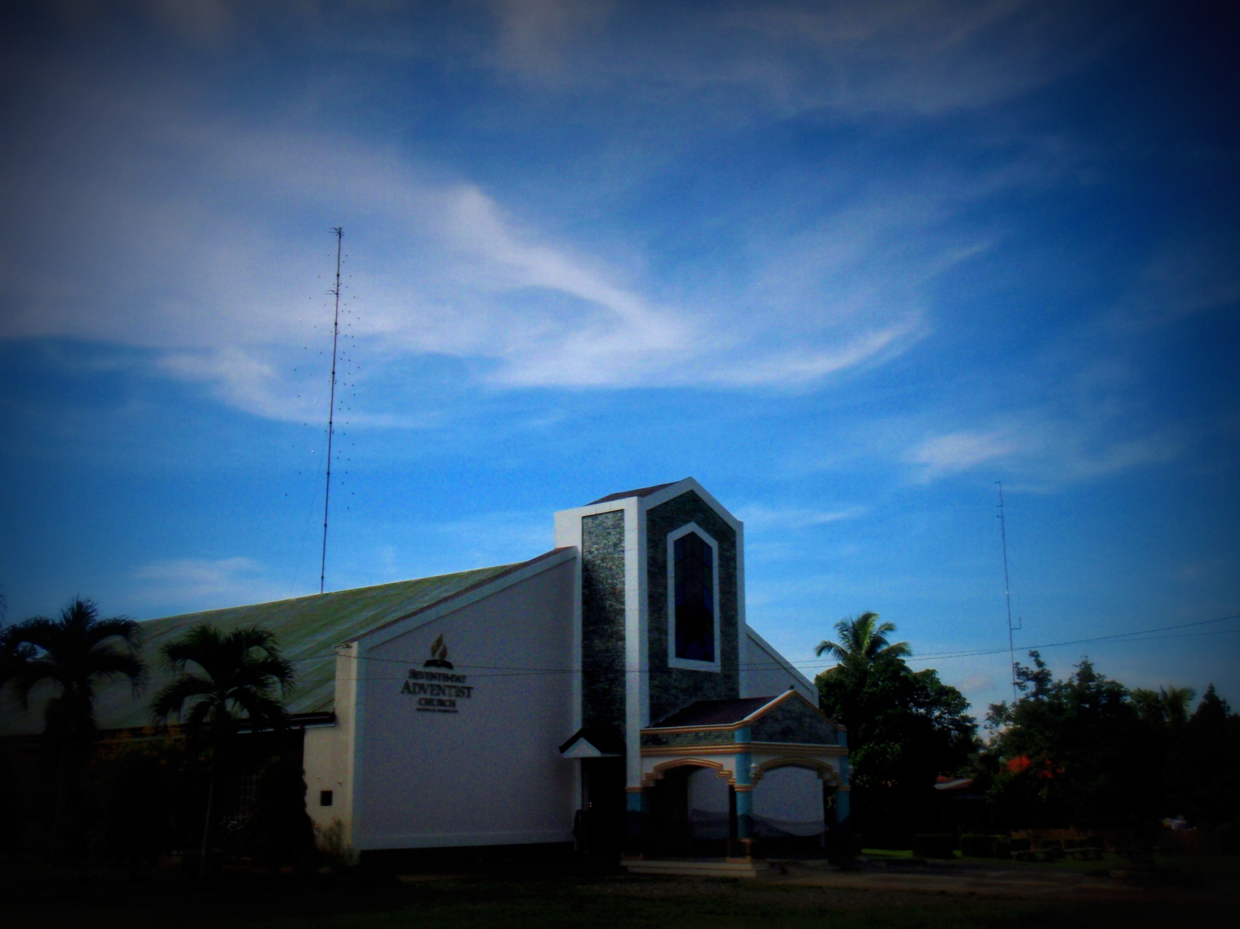
VISIT OUR CHURCH WEBSITE
www.longvineradio.listen2myradio.com

Slide 8

www.longvineradio.listen2myradio.com
96.9 MHz DXBP FM
Longvine Hope Radio
KAPAGLAUM … ..Bagontaas Seventh – day Adventist
Church, Valencia City, Bukidnon, Philippines

Slide 9


Slide 10
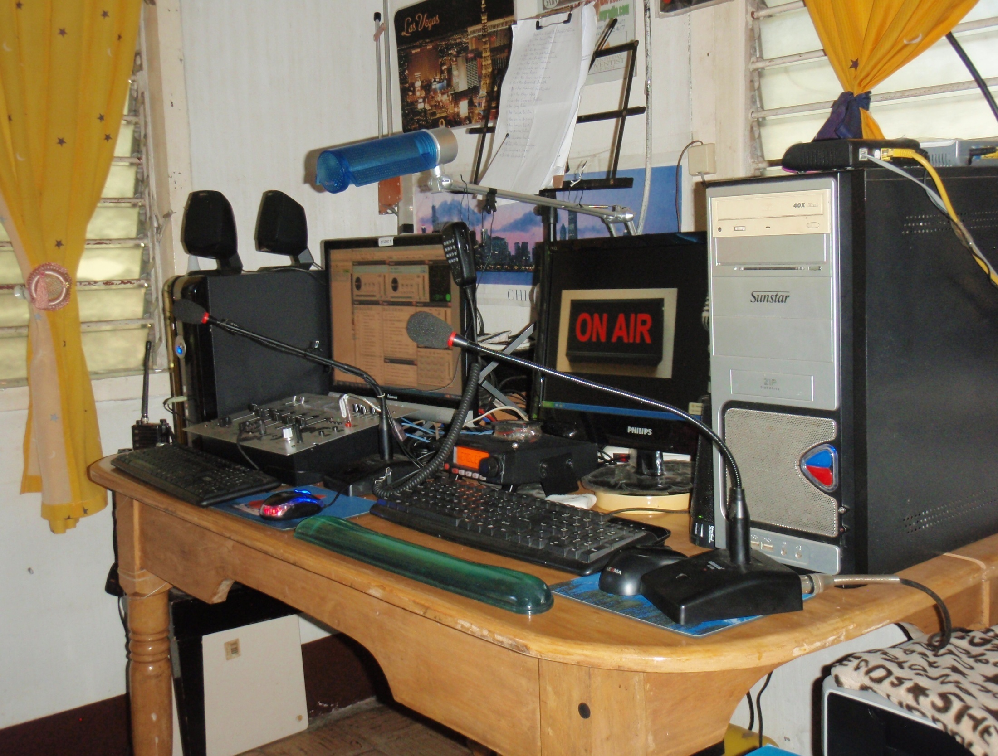

Slide 11
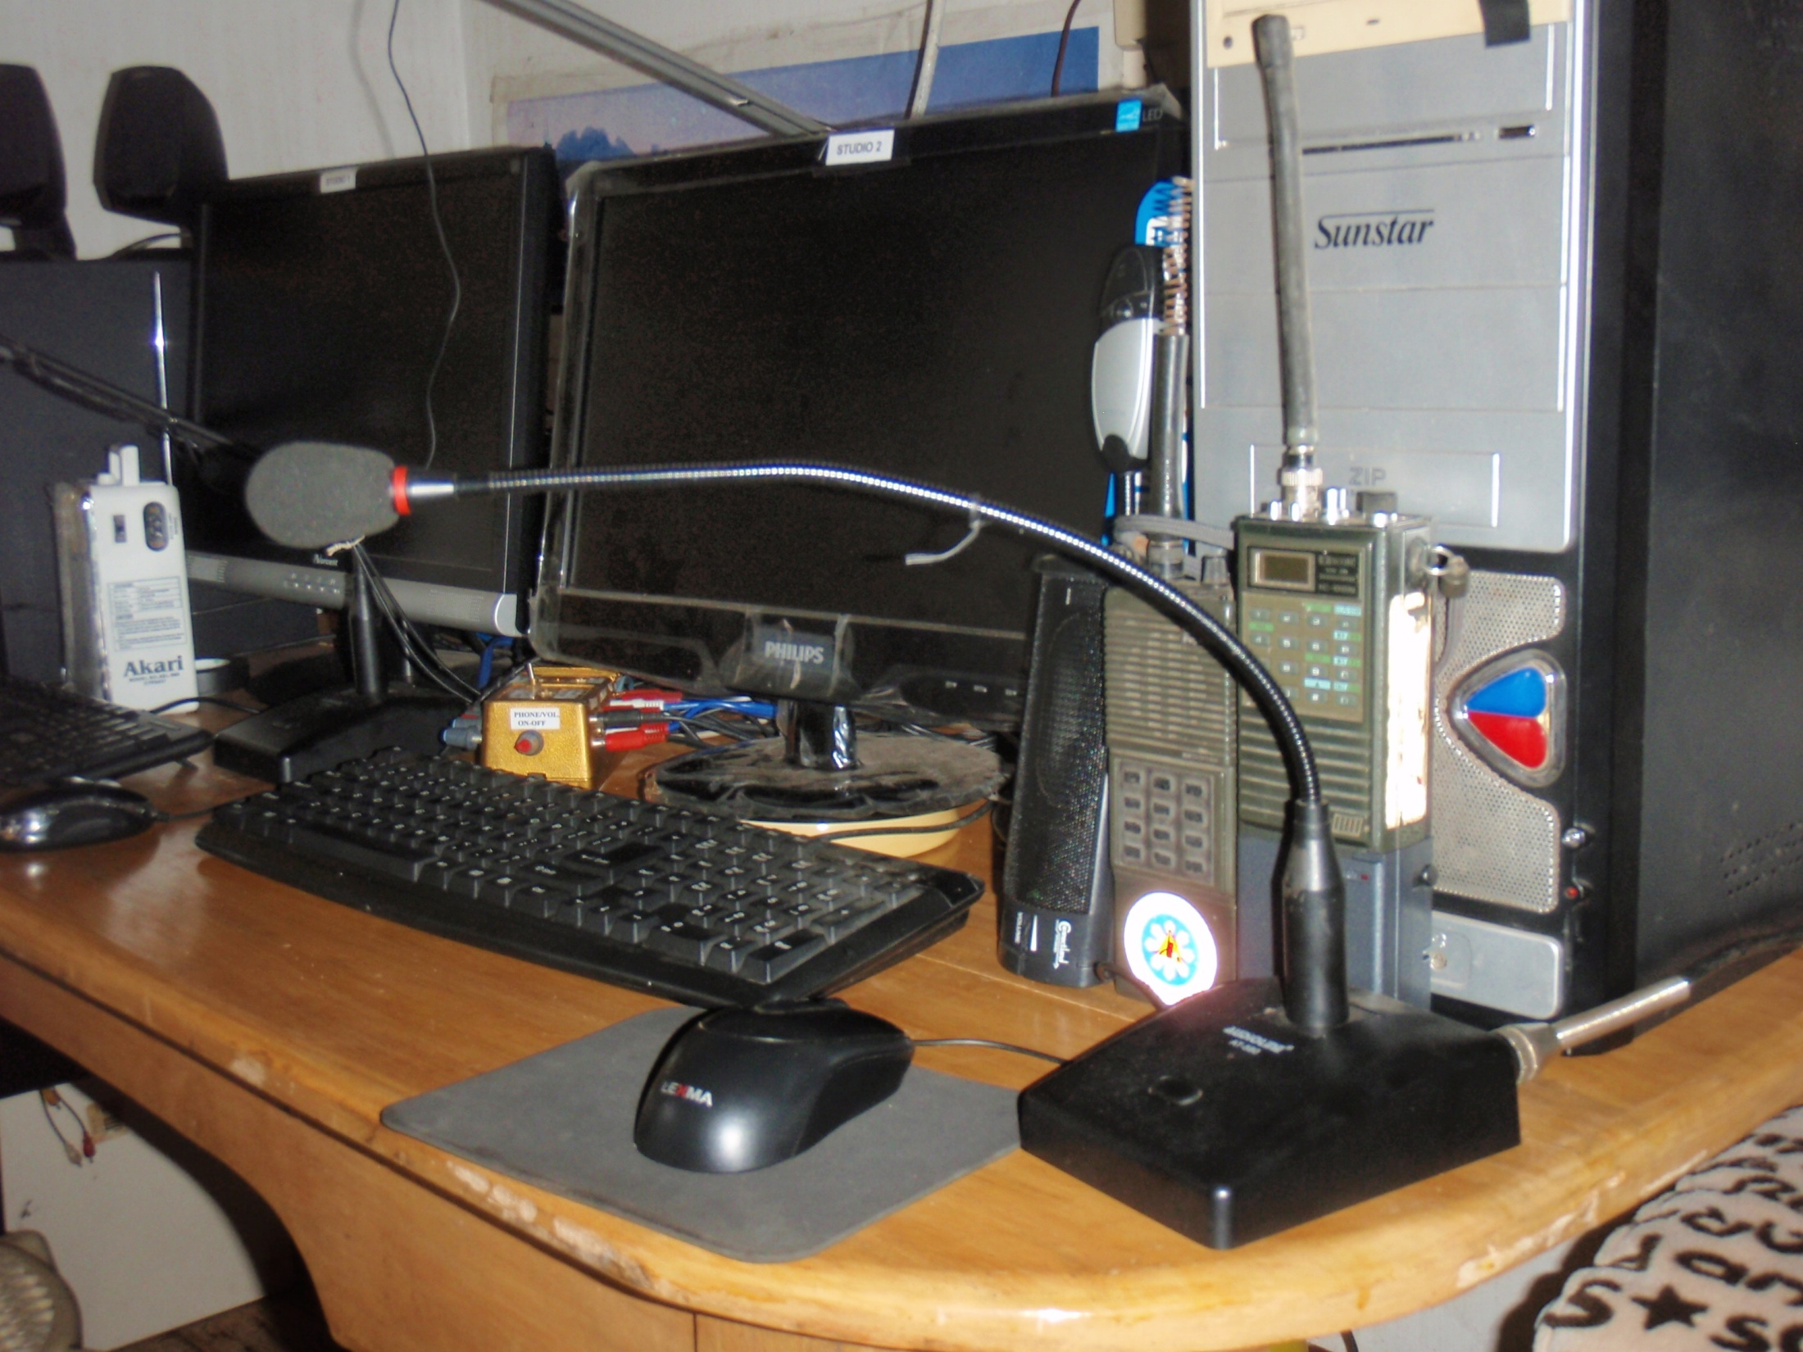

Slide 12
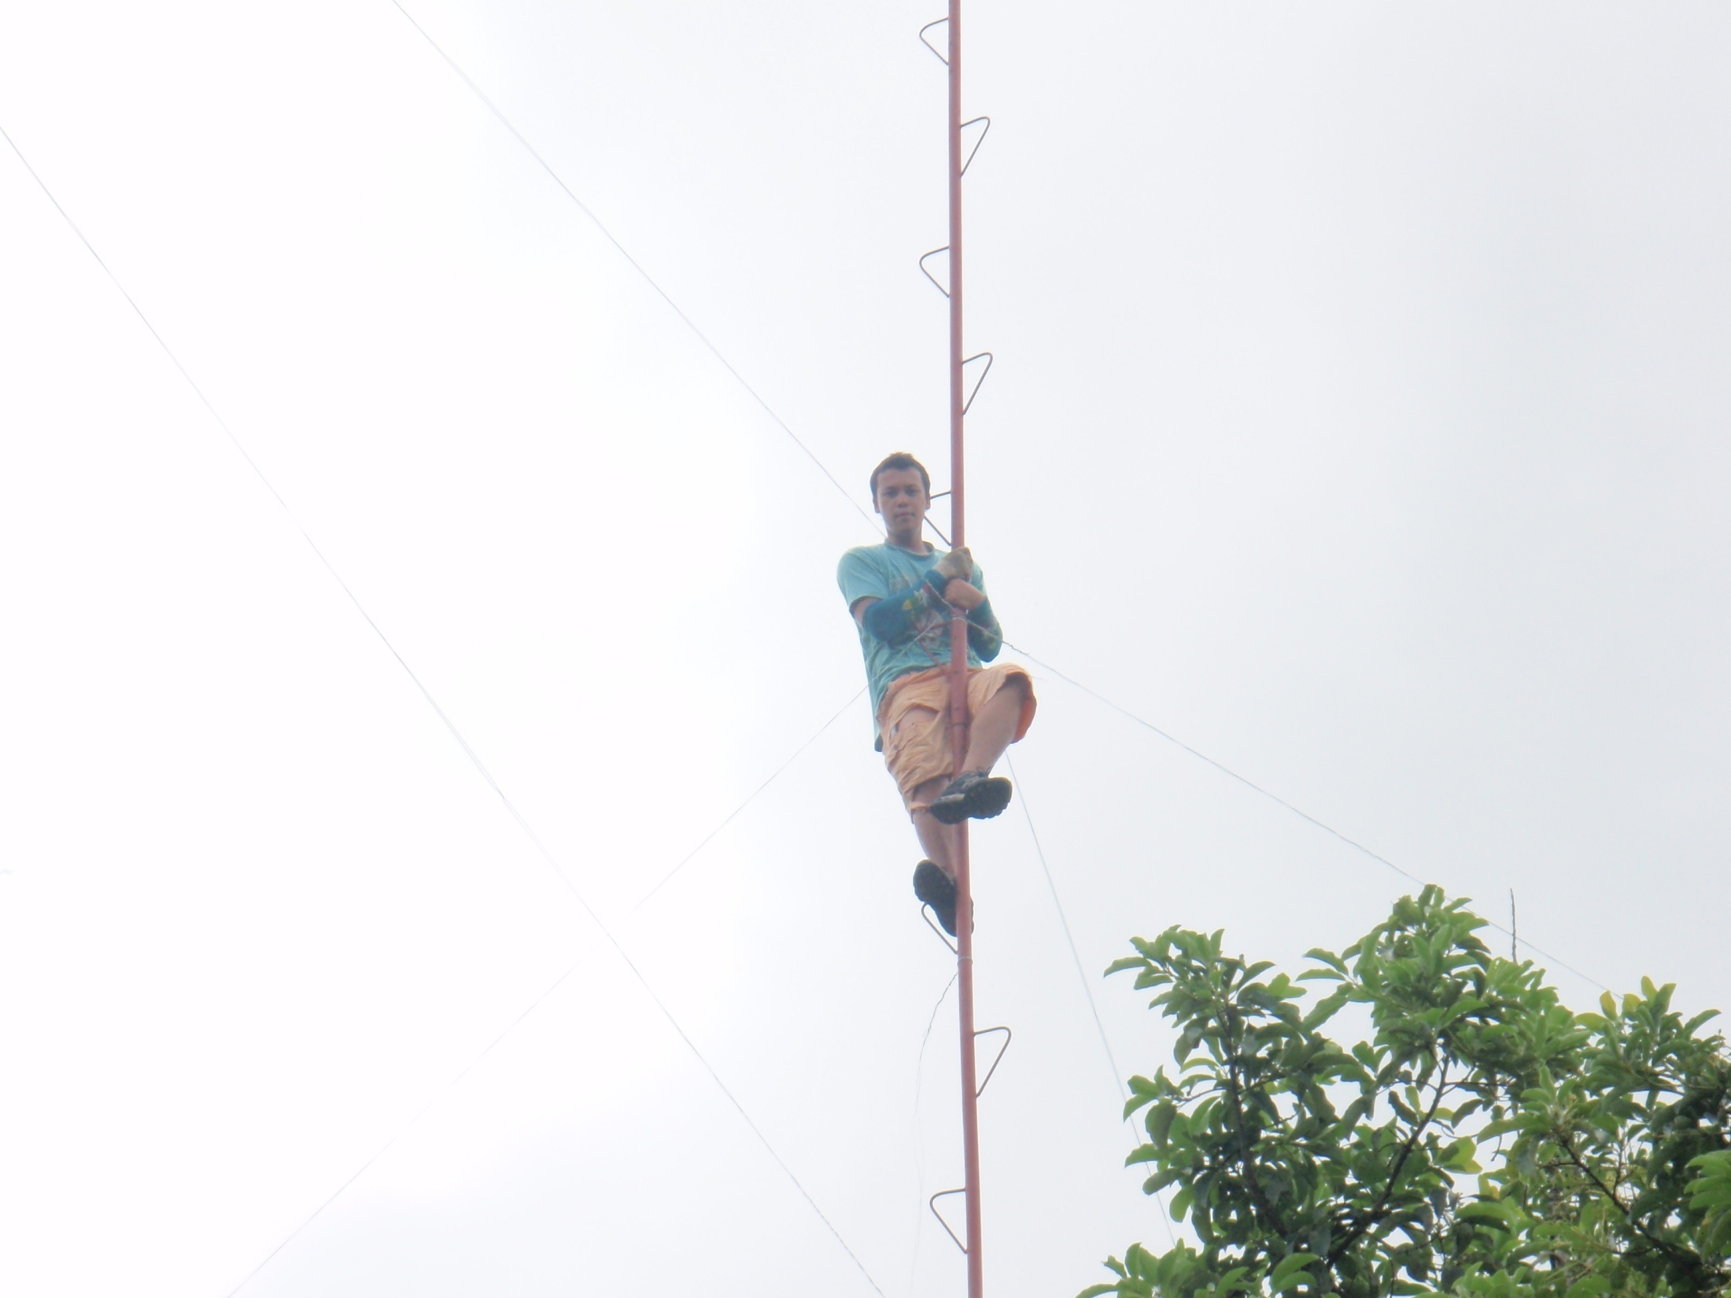

Slide 13
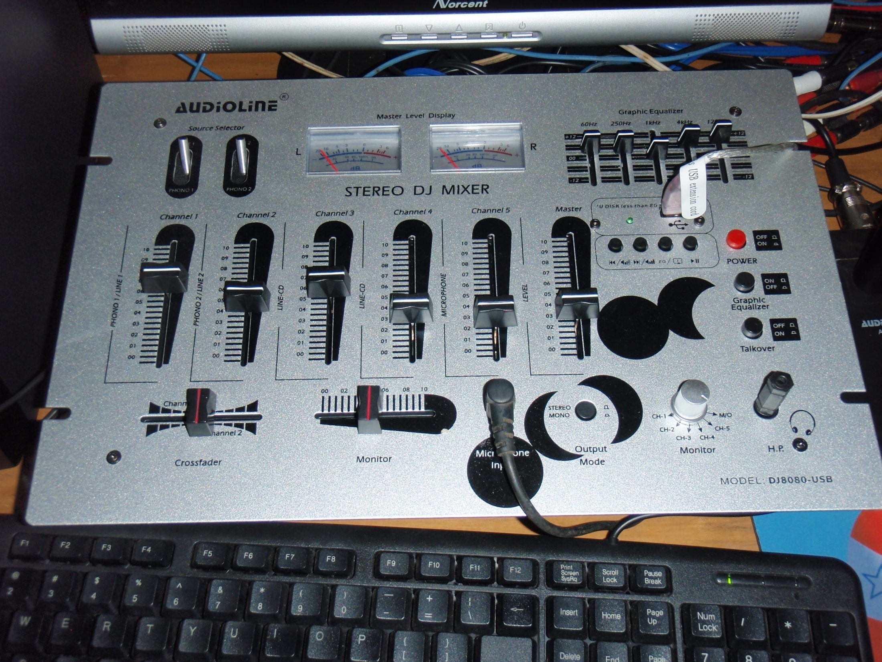

Slide 14
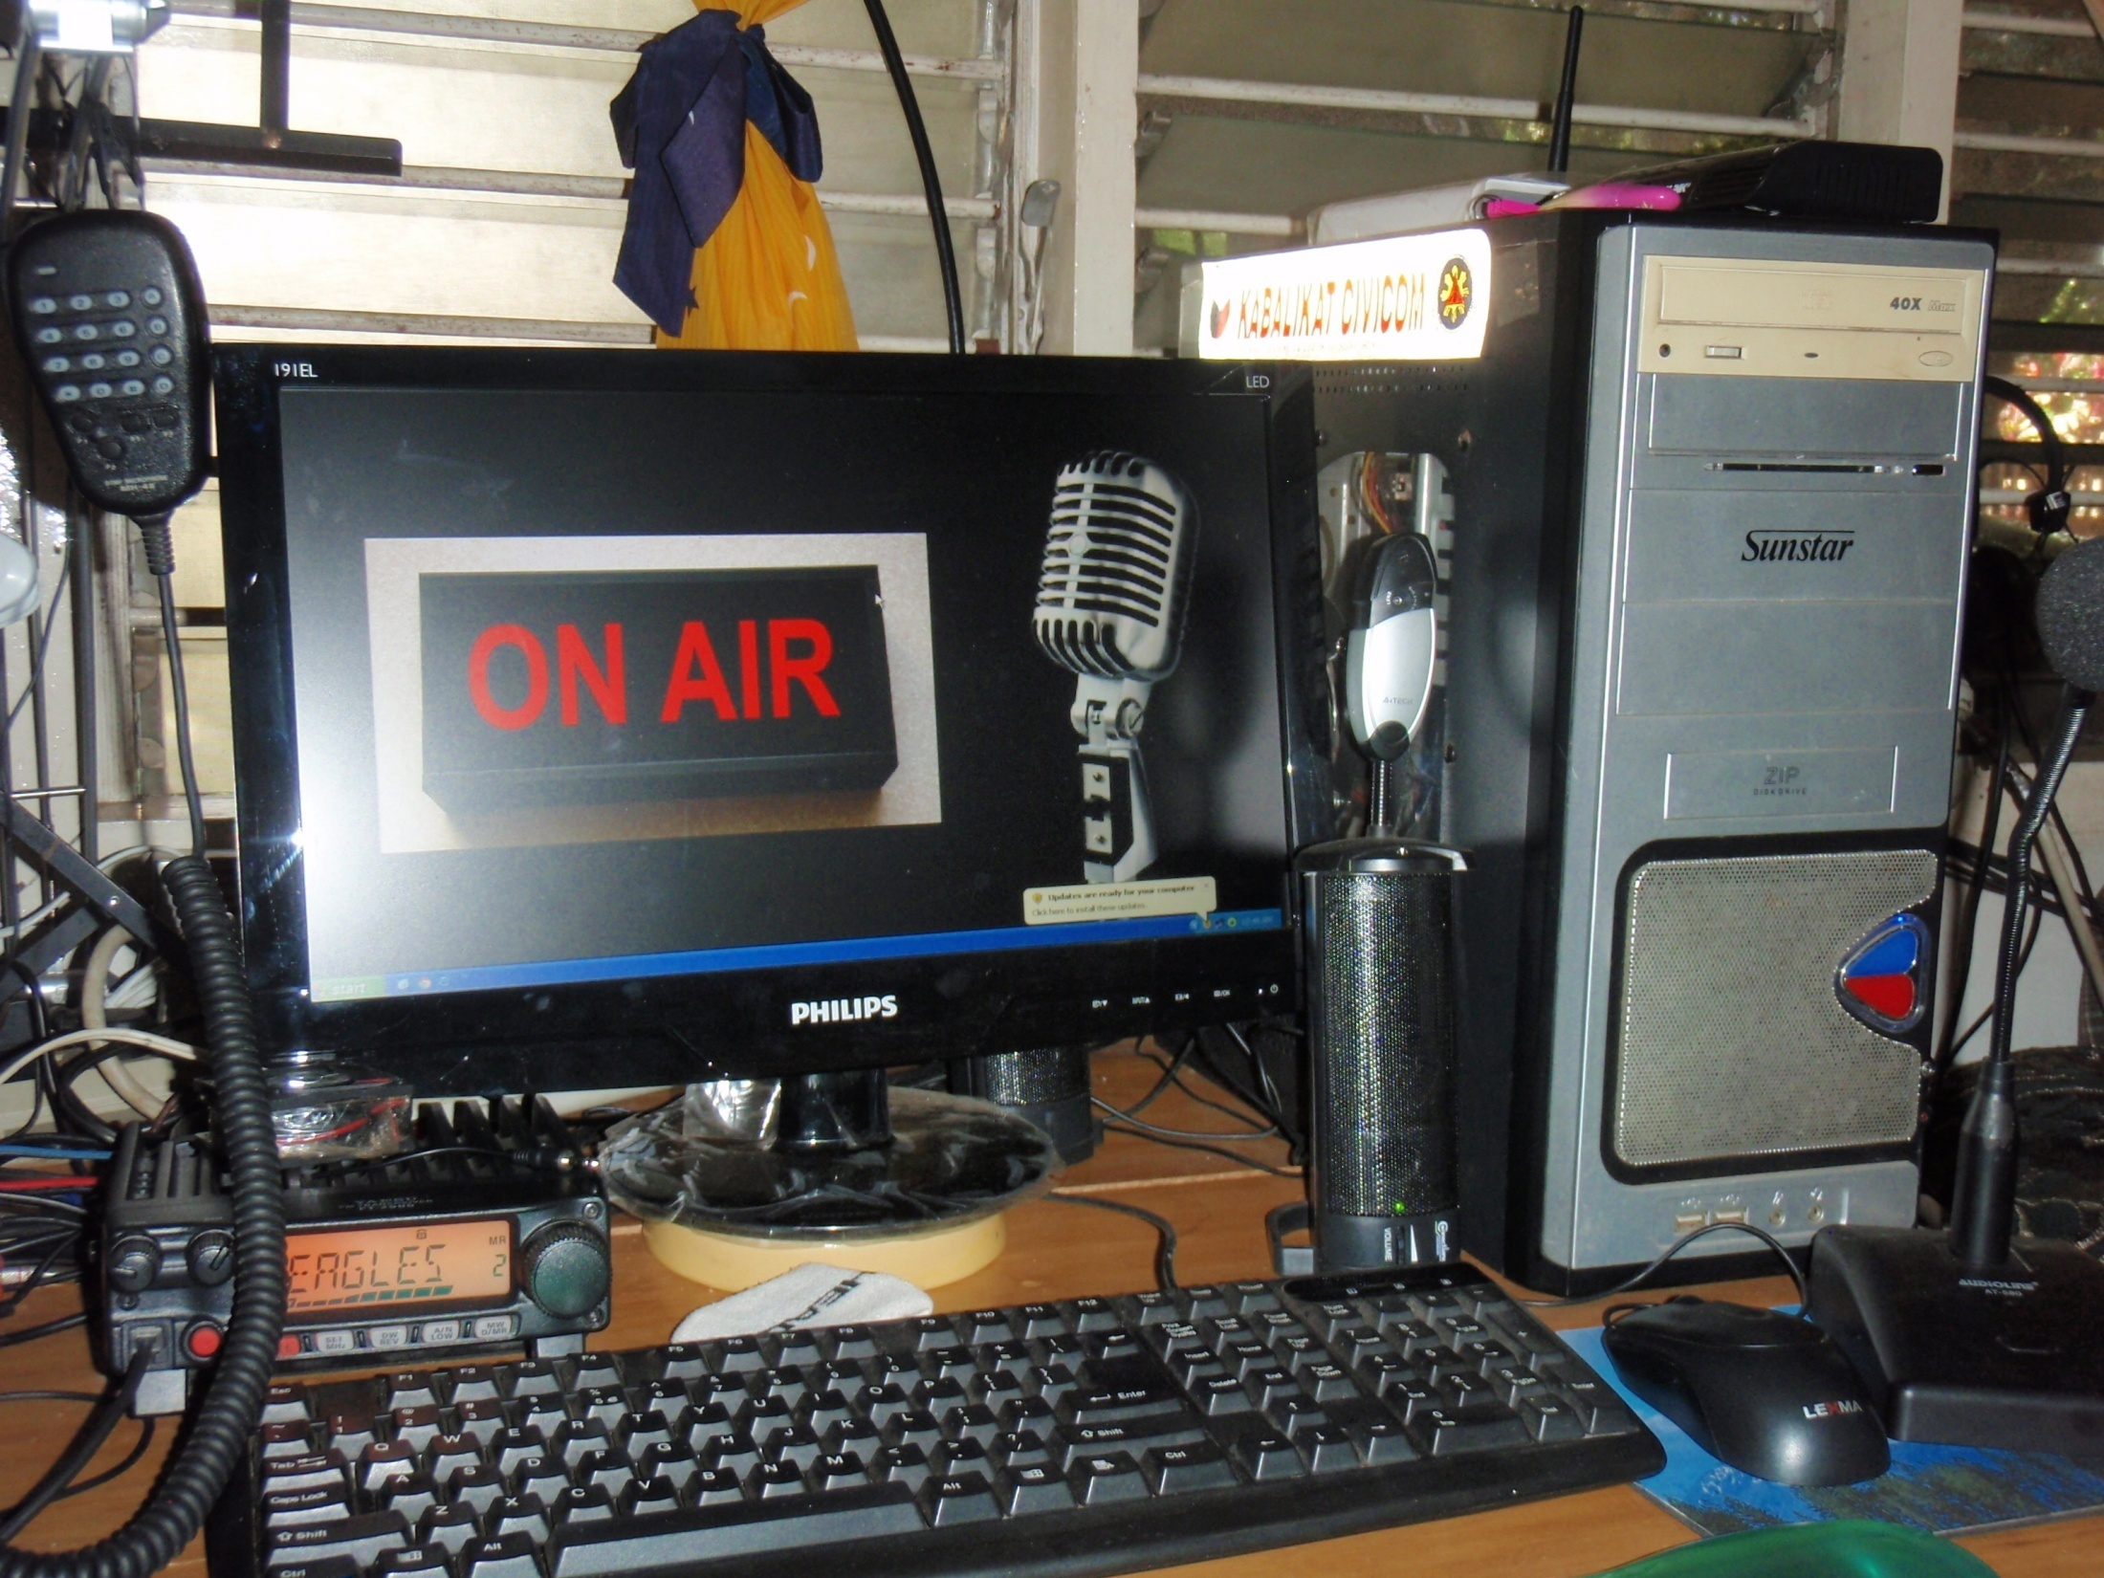

Slide 15
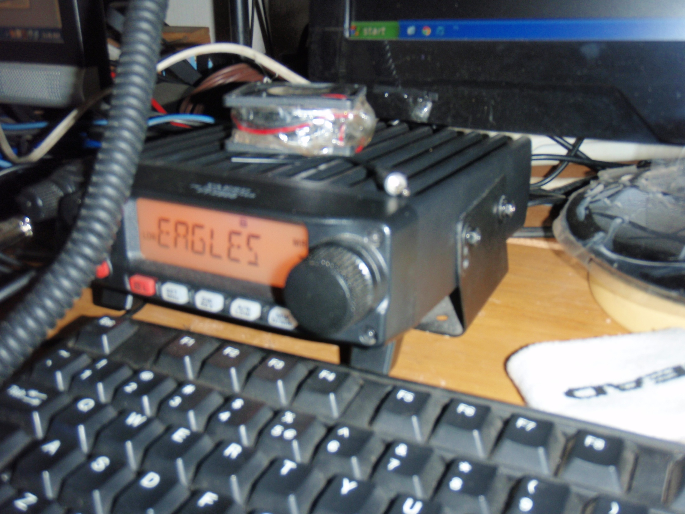

Slide 16
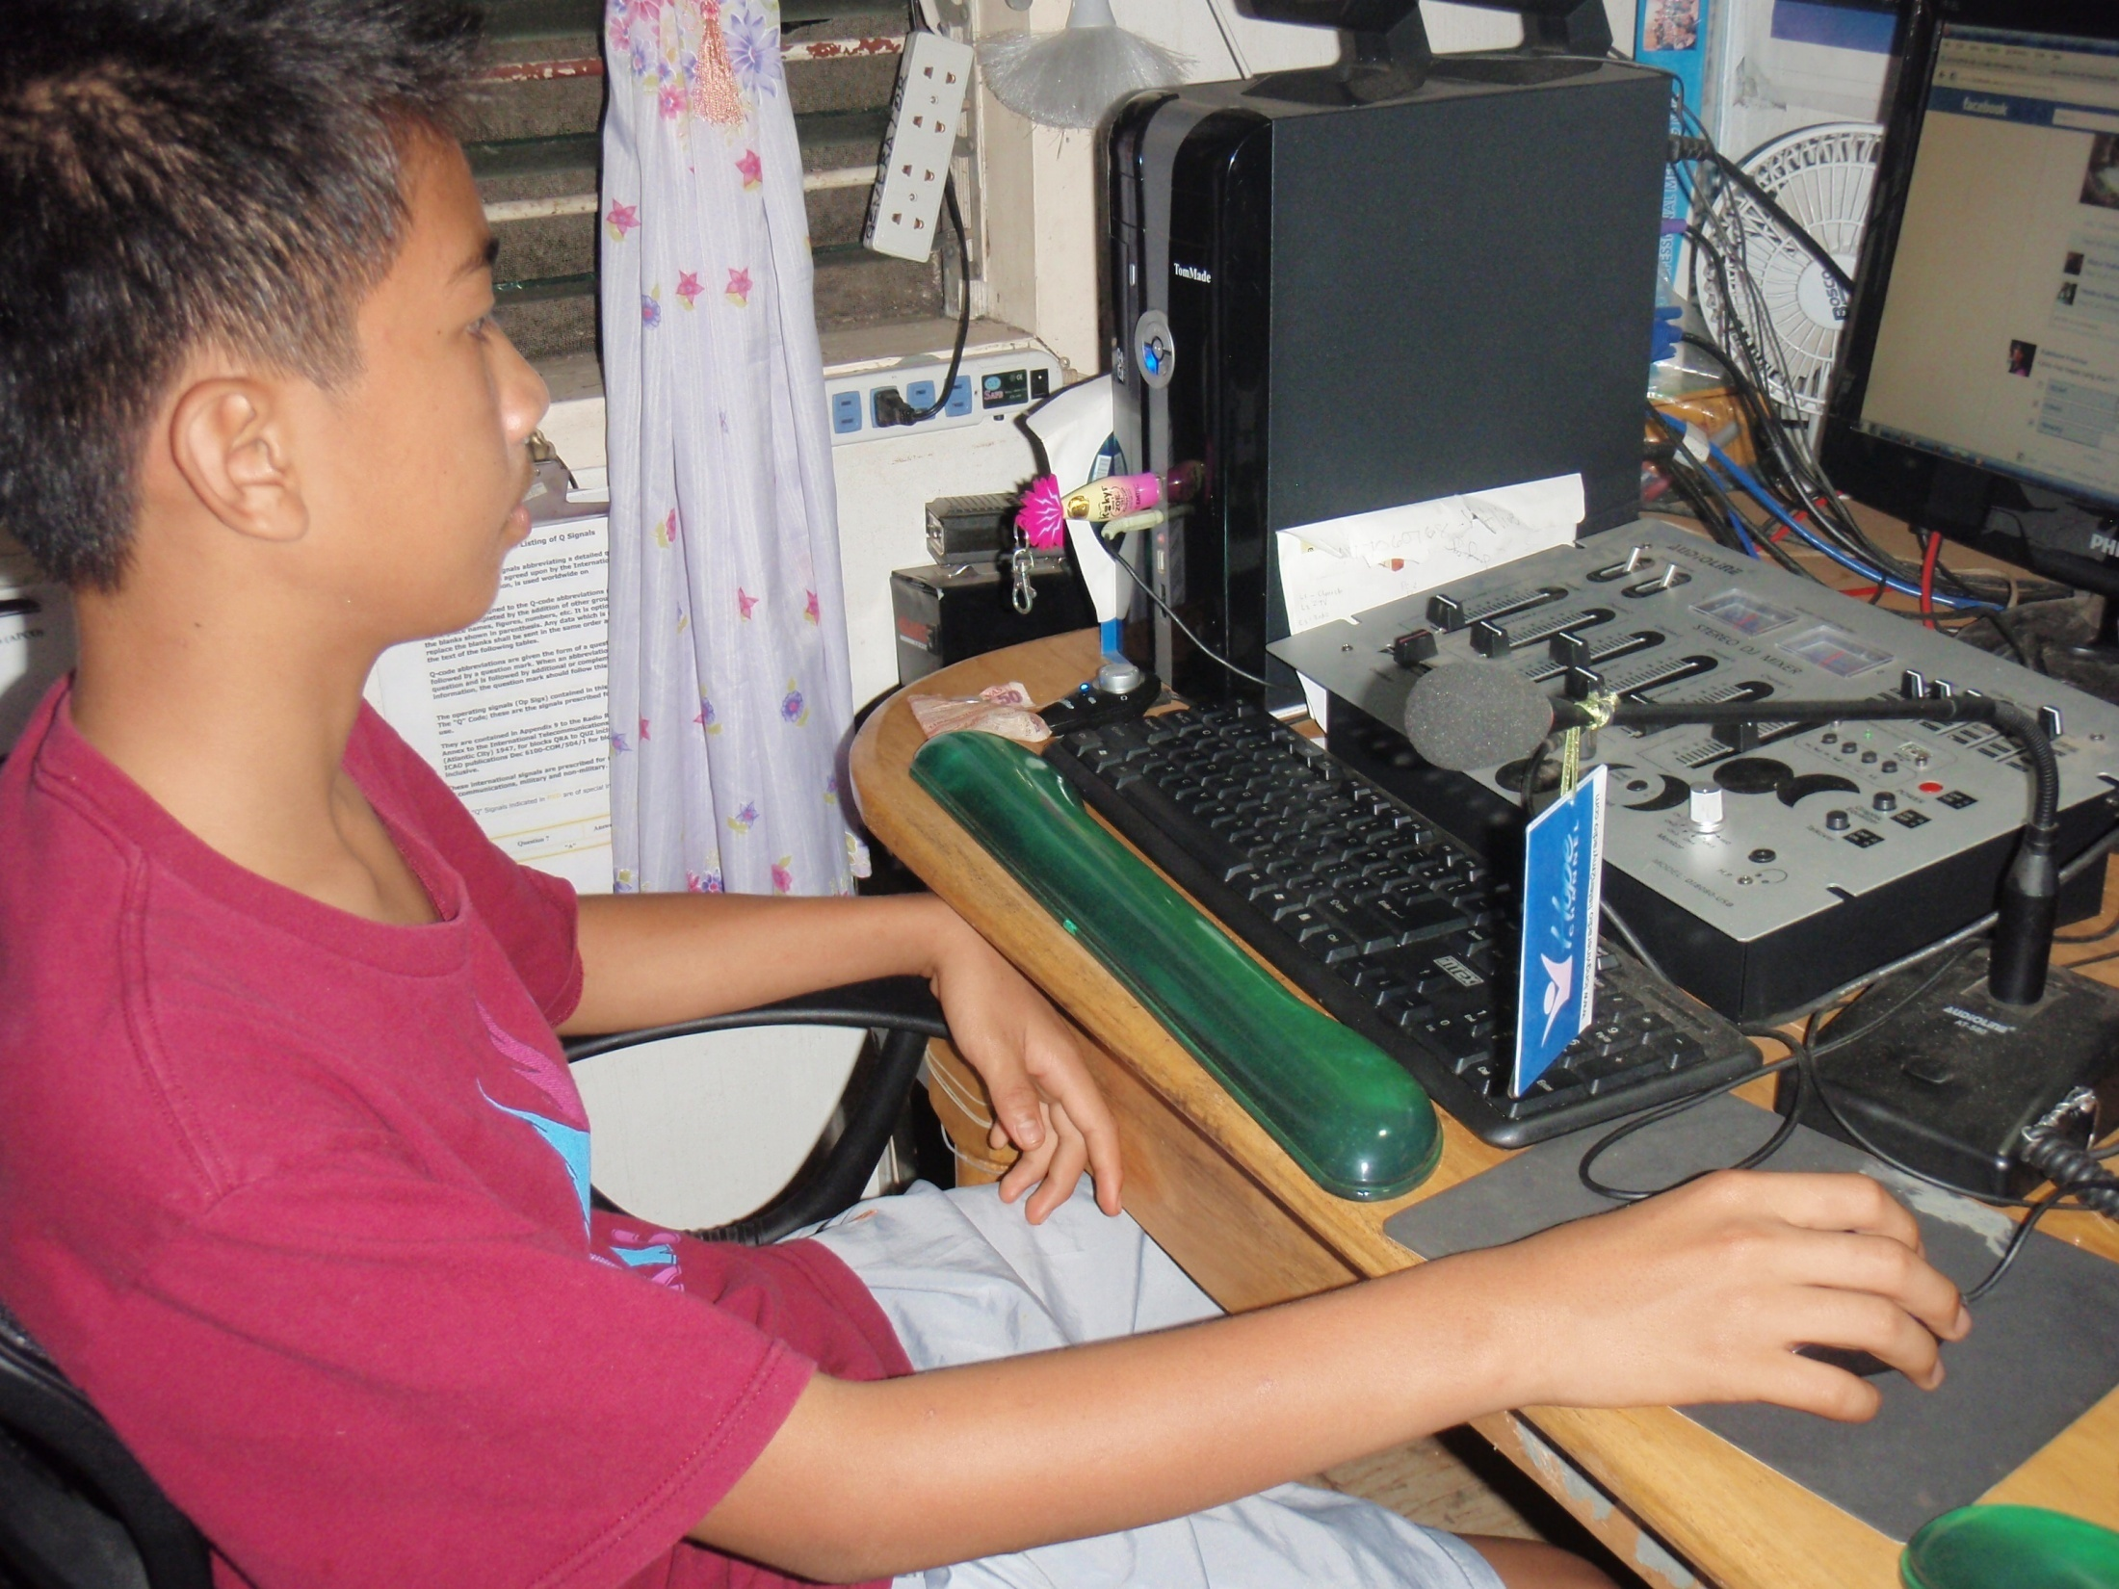

Slide 17


Slide 18
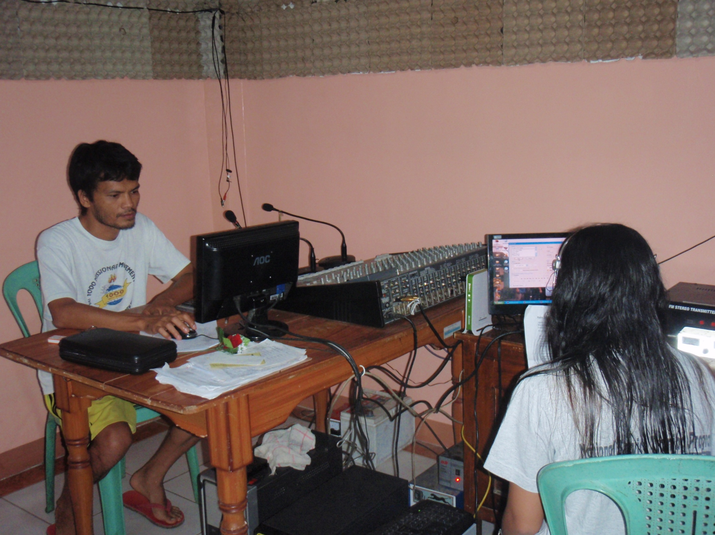

Slide 19
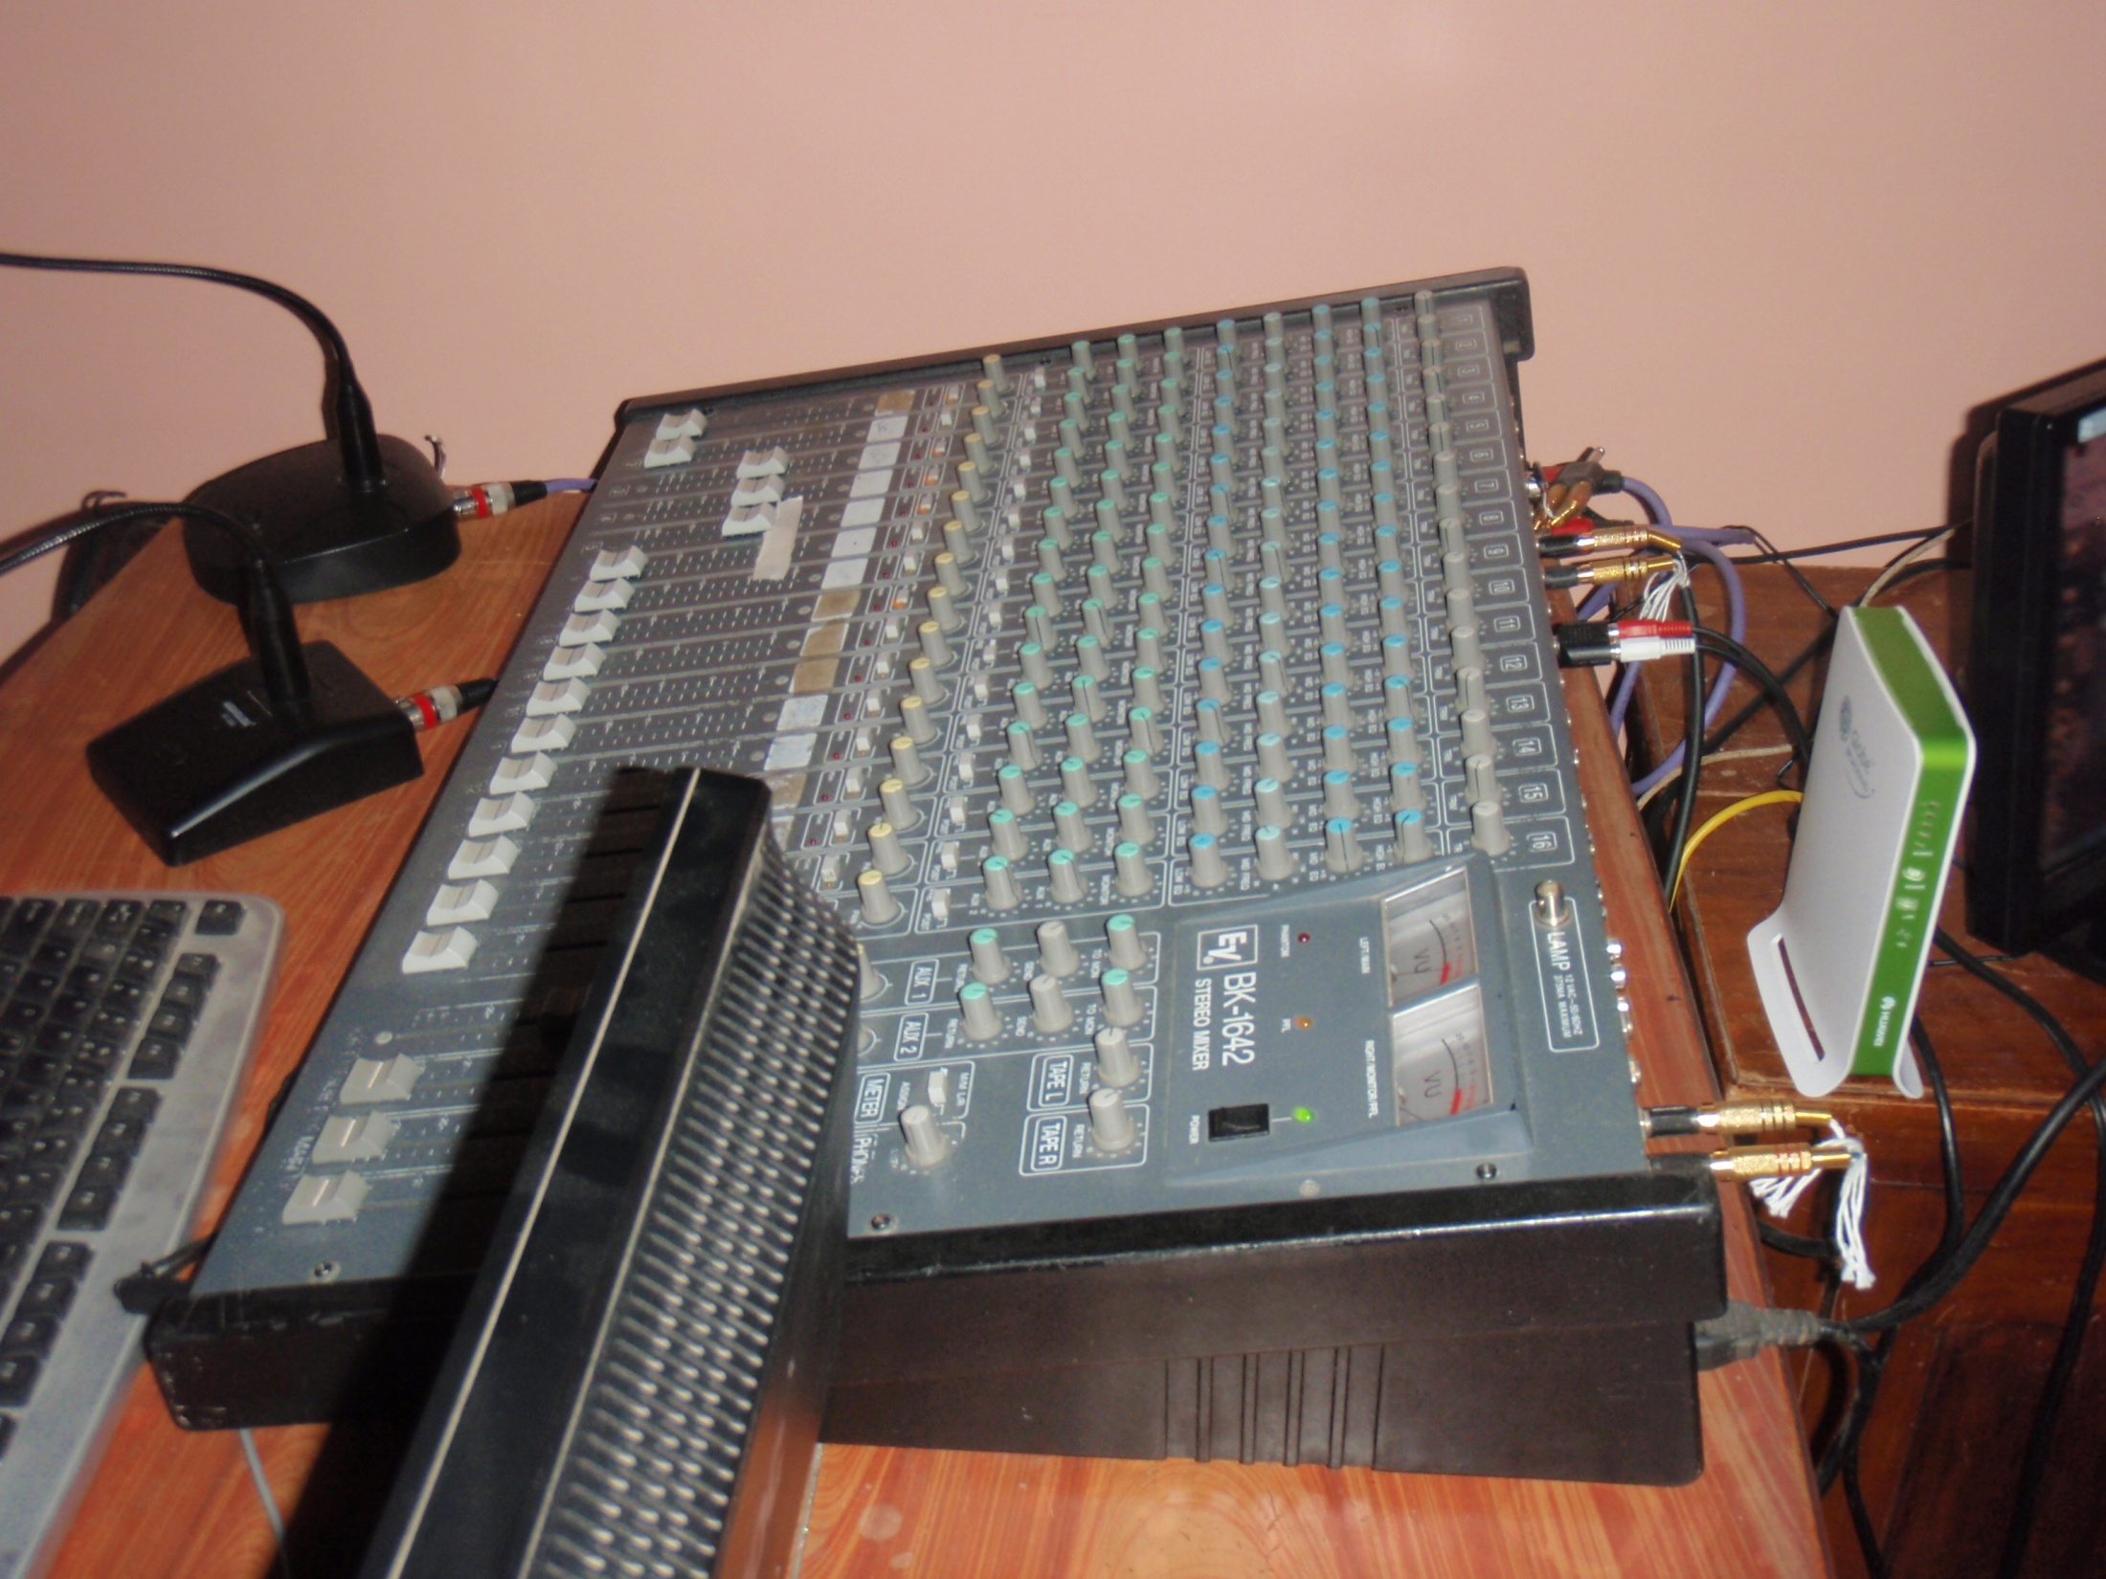

Slide 20
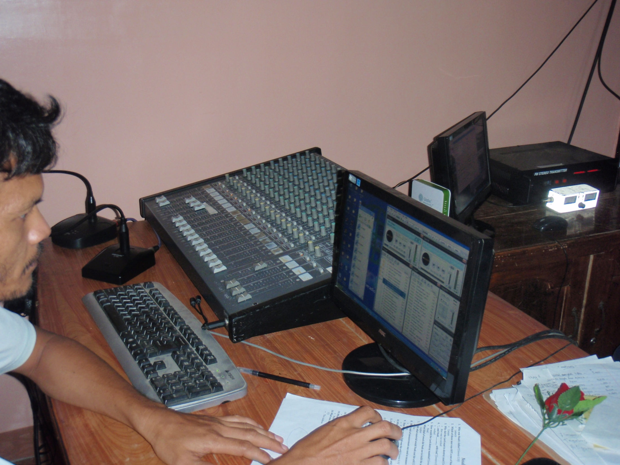

Slide 21
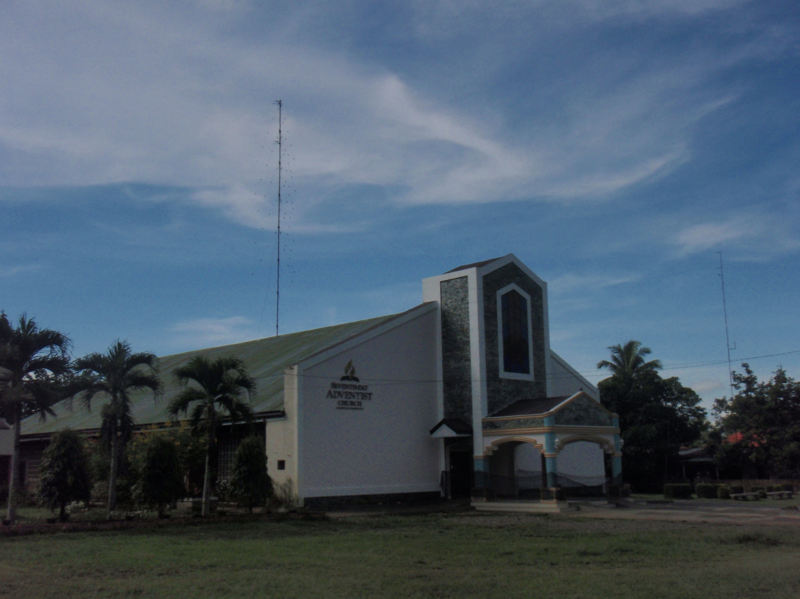

Slide 22
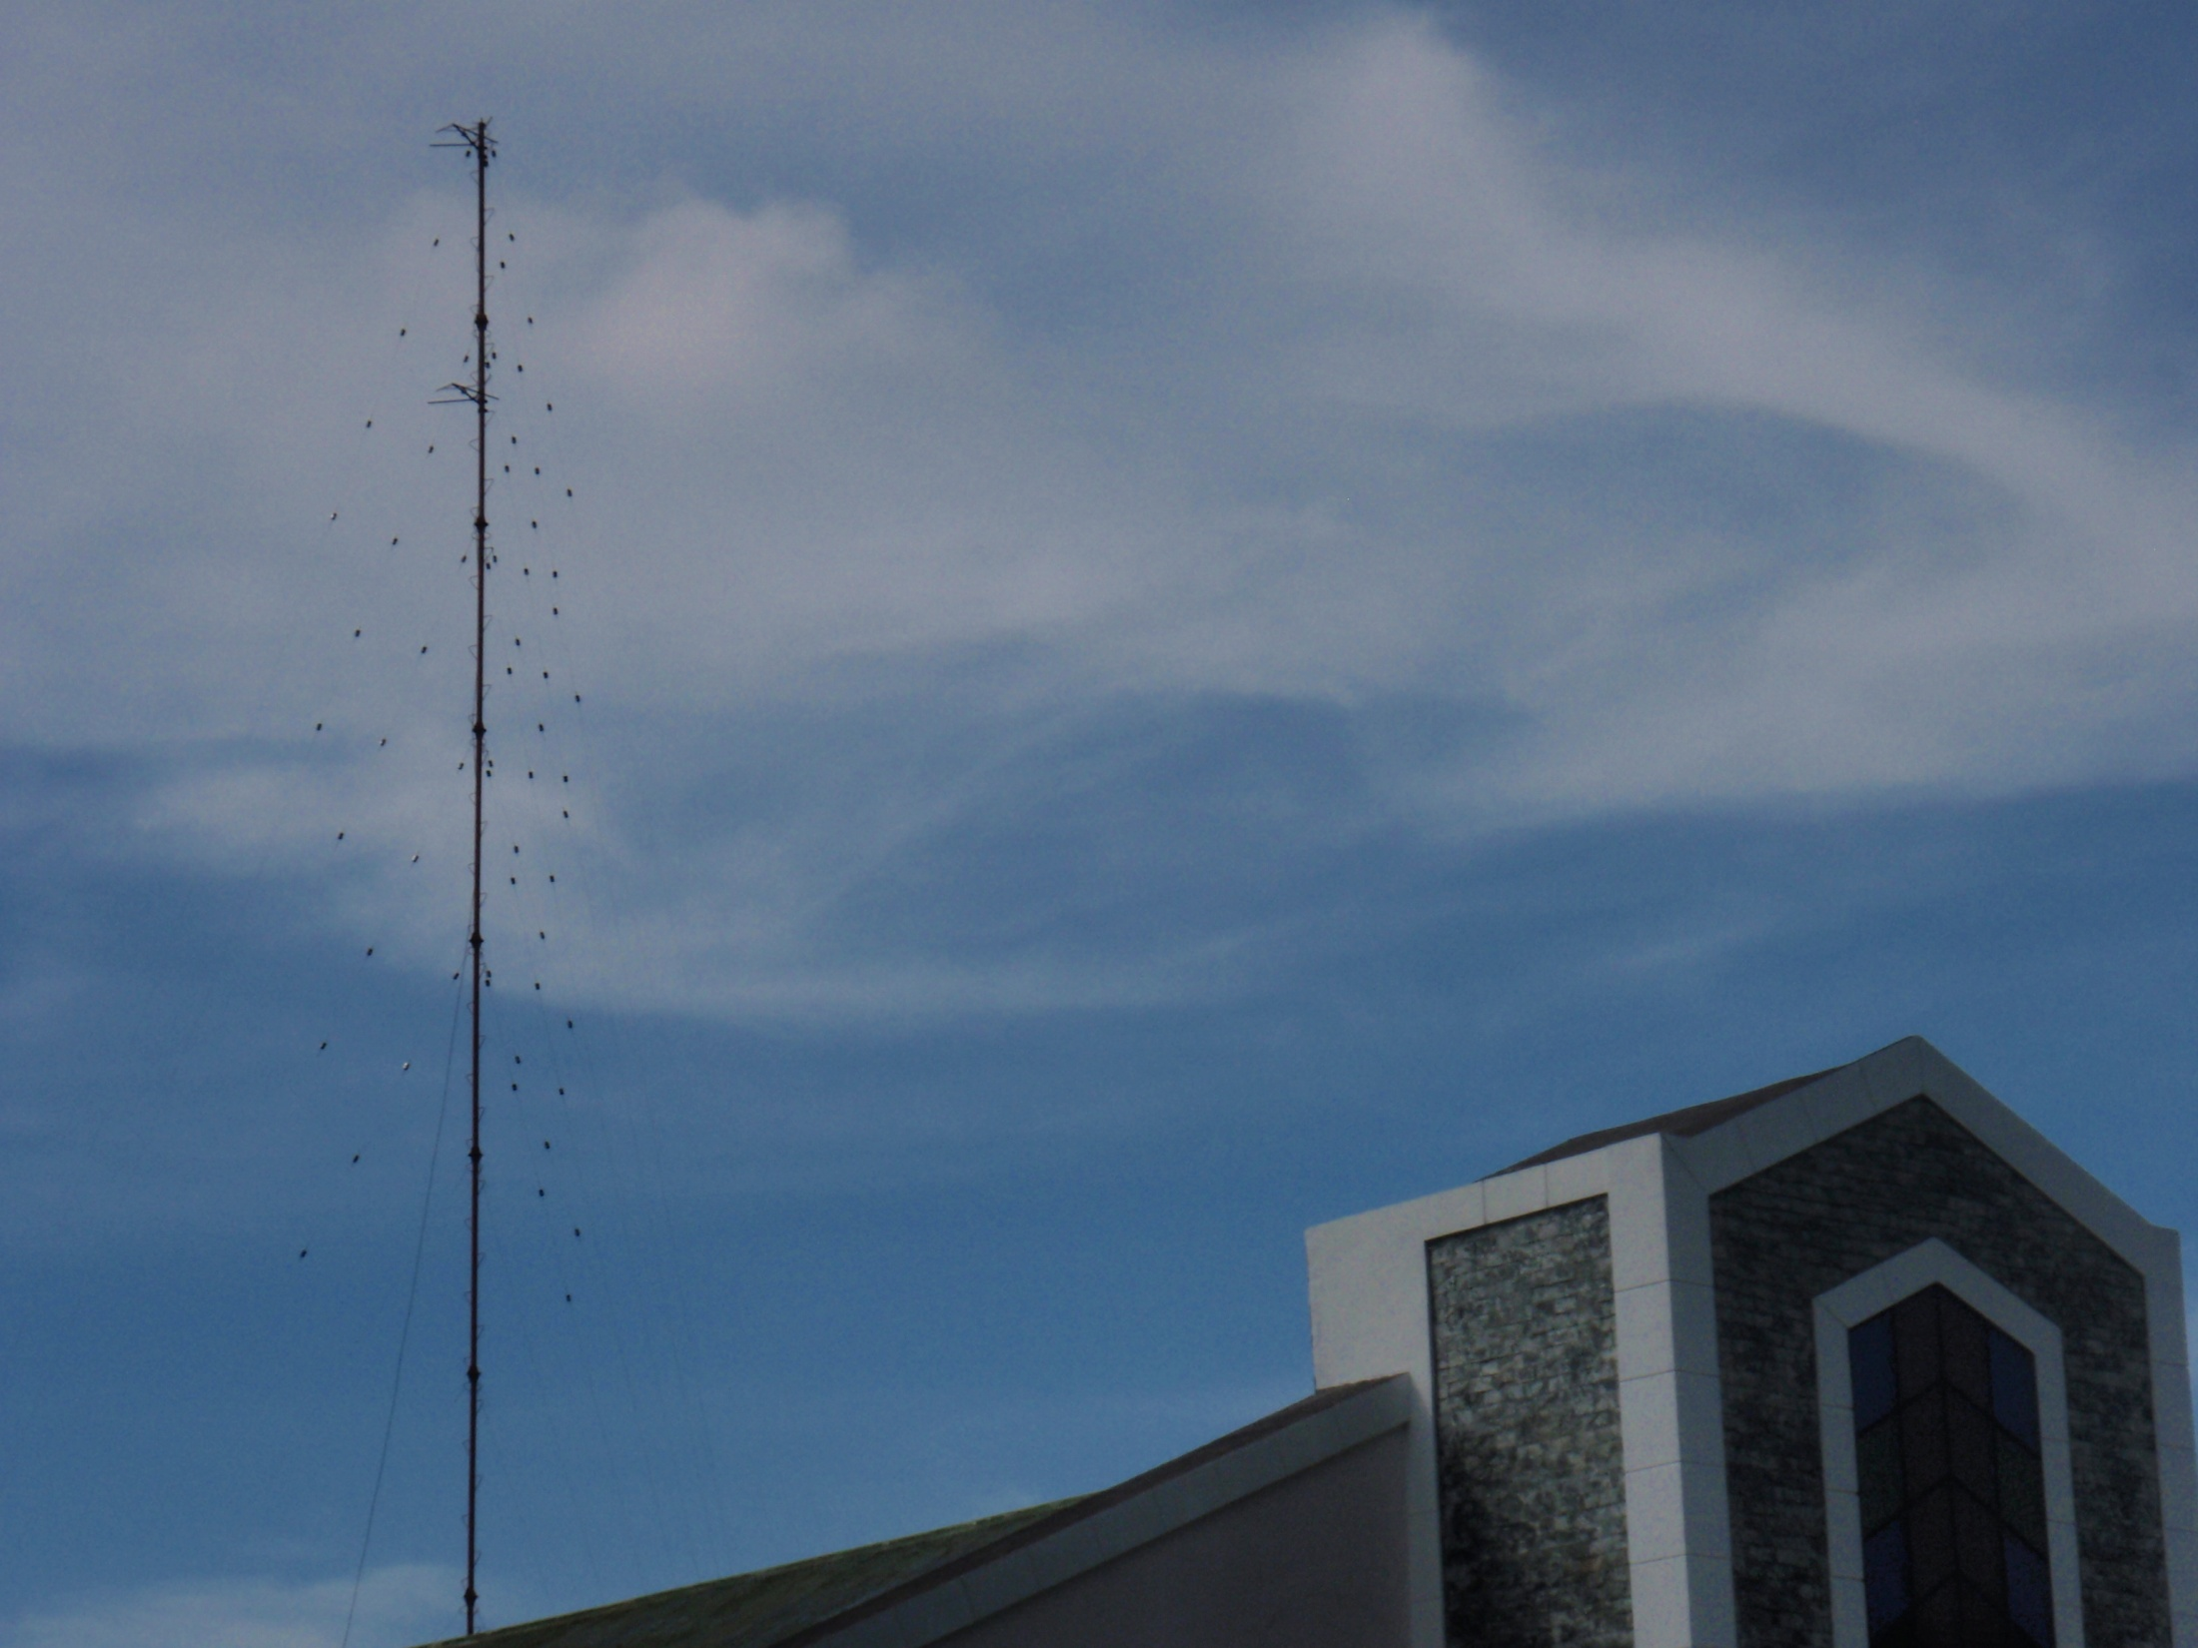

Slide 23
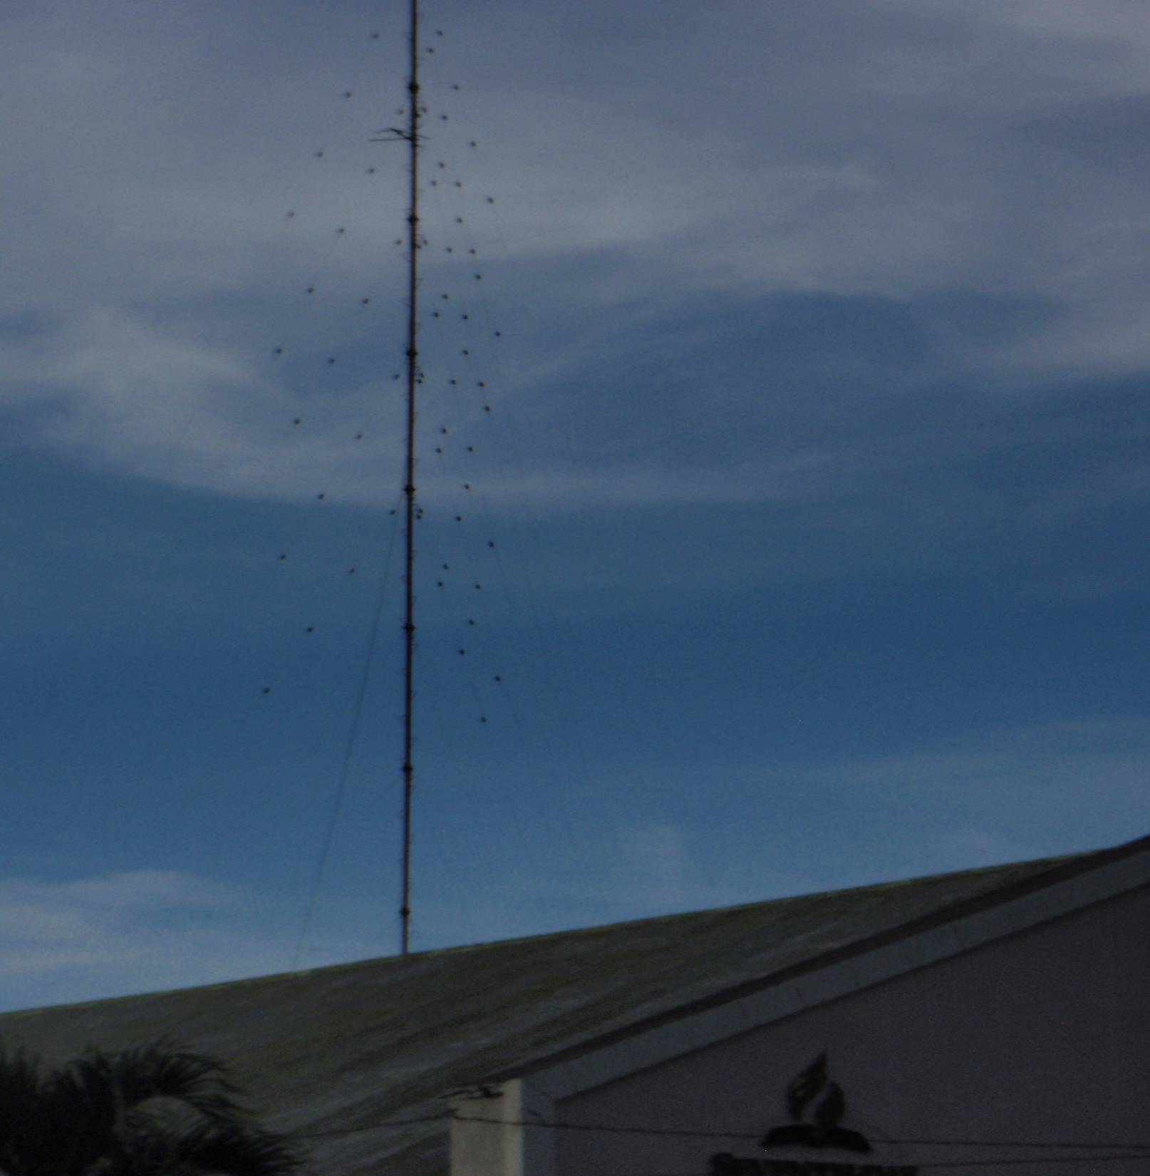

Slide 24
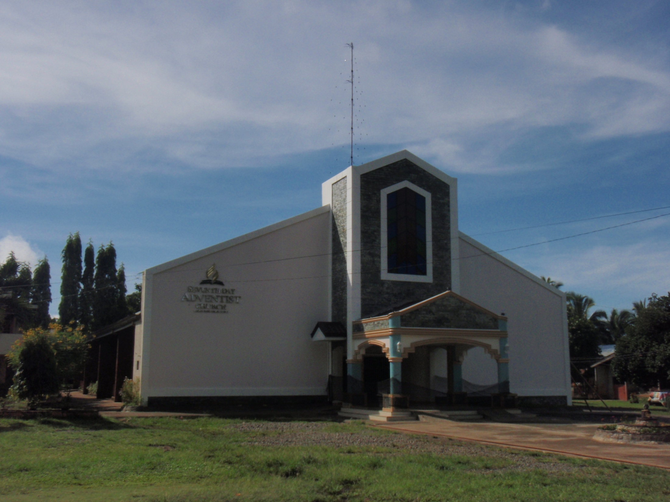
Proclaiming Gods Grace throughout the whole world

Slide 25
VISIT OUR CHURCH WEBSITE
www.longvineradio.listen2myradio.com

Slide 26
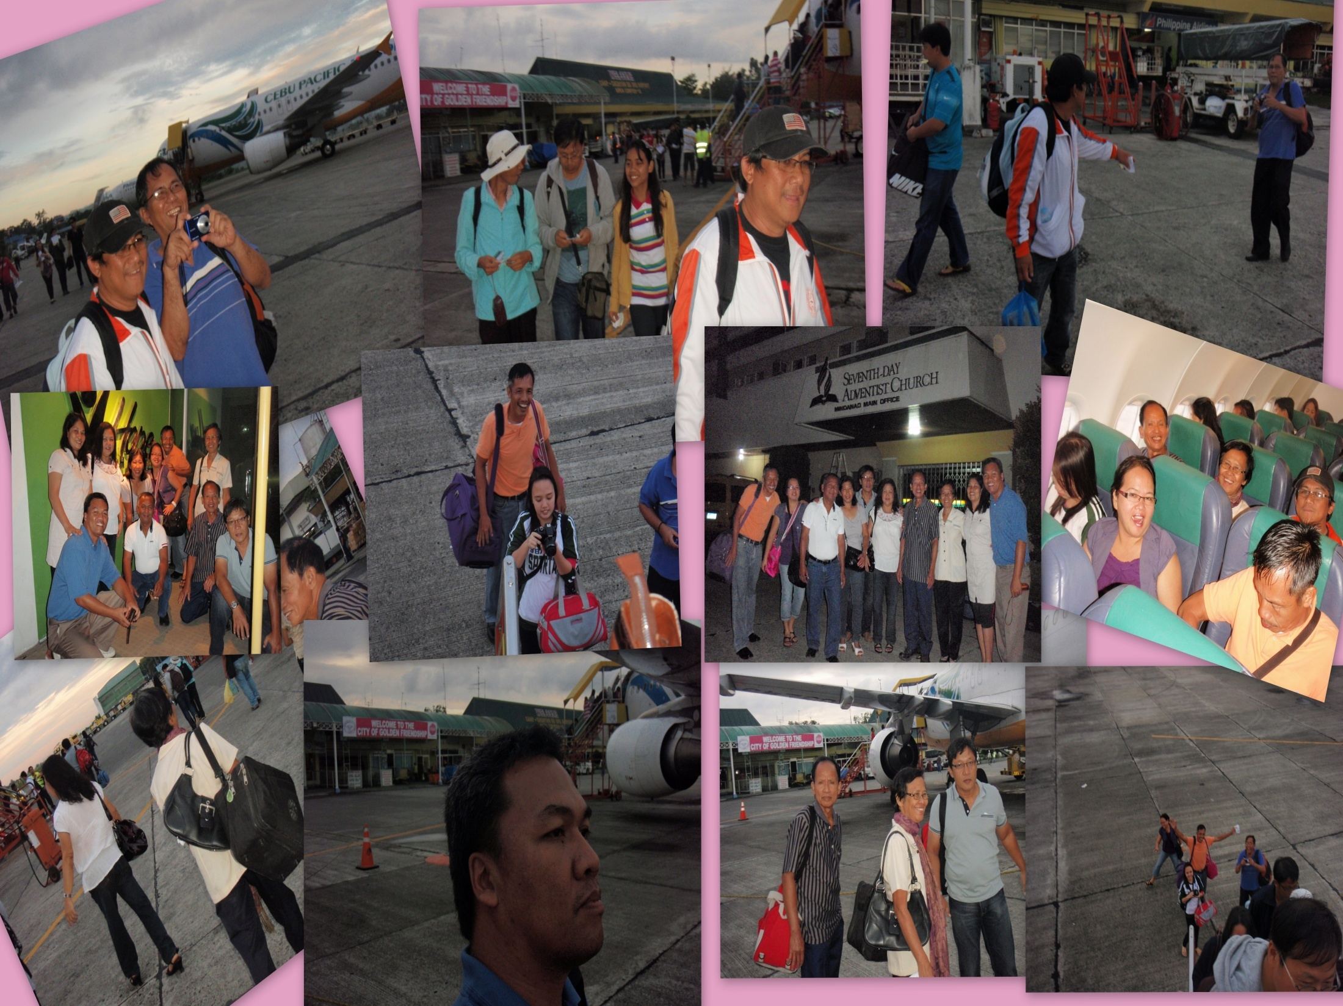

Slide 27
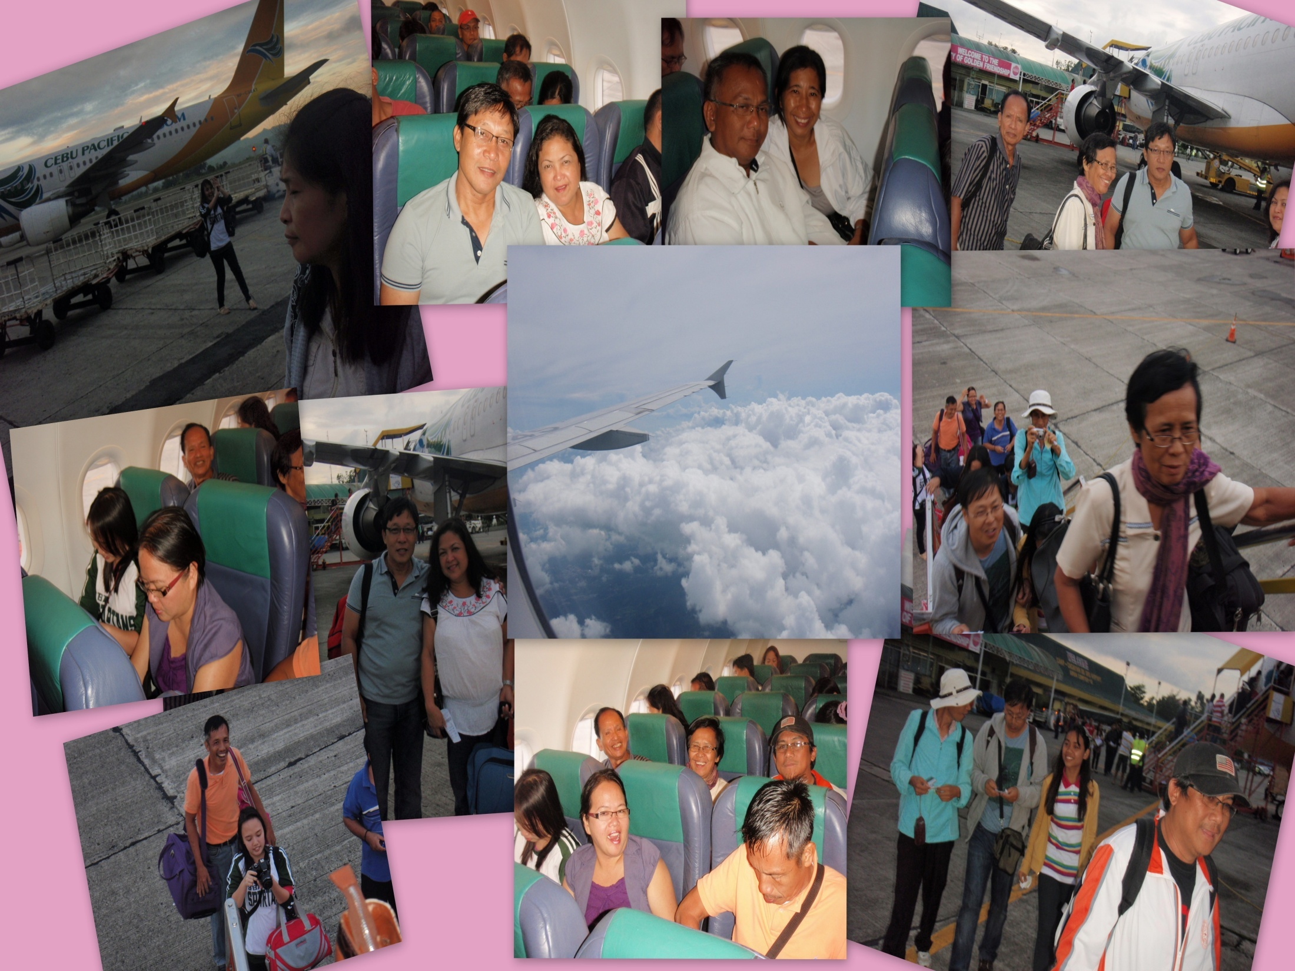

Slide 28
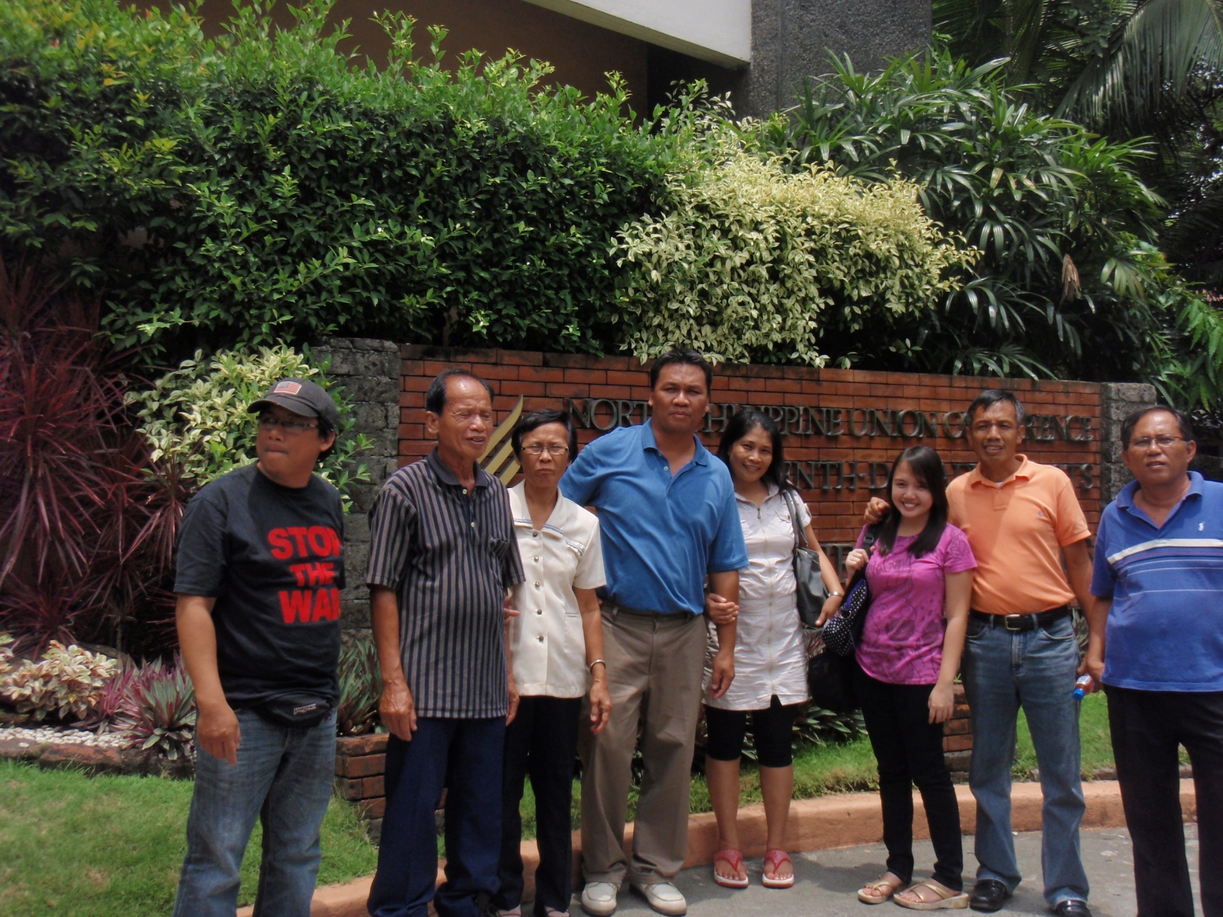

Slide 29
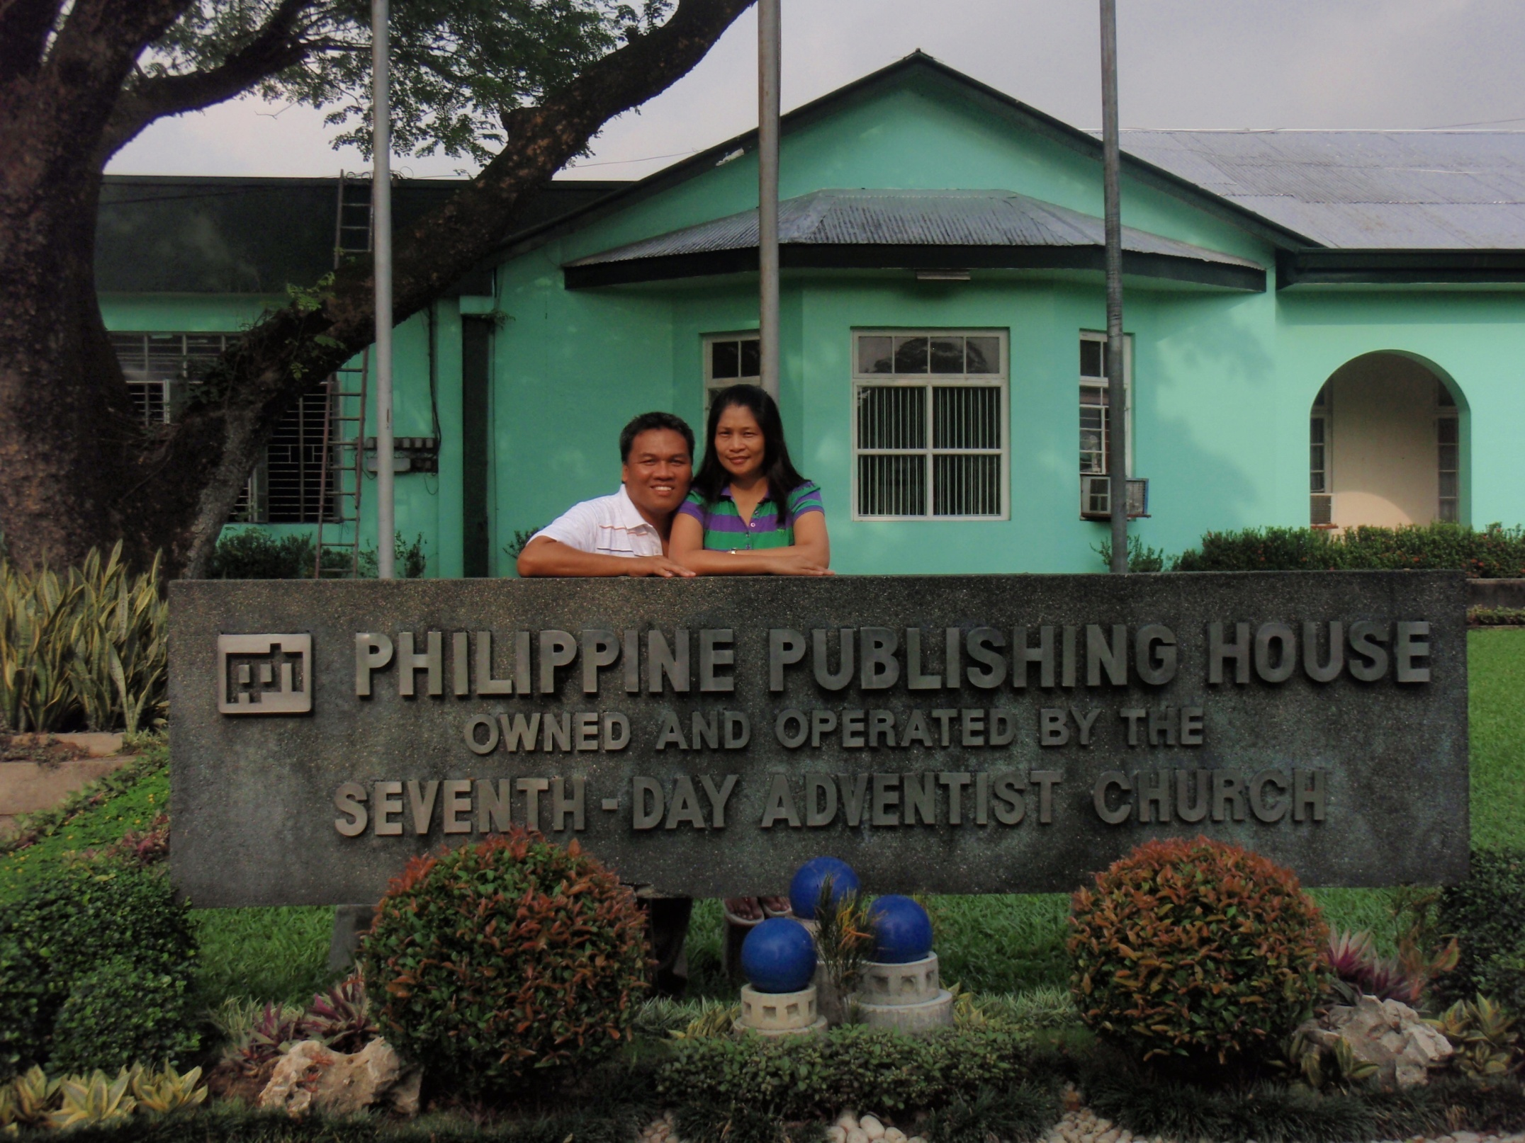

Slide 30
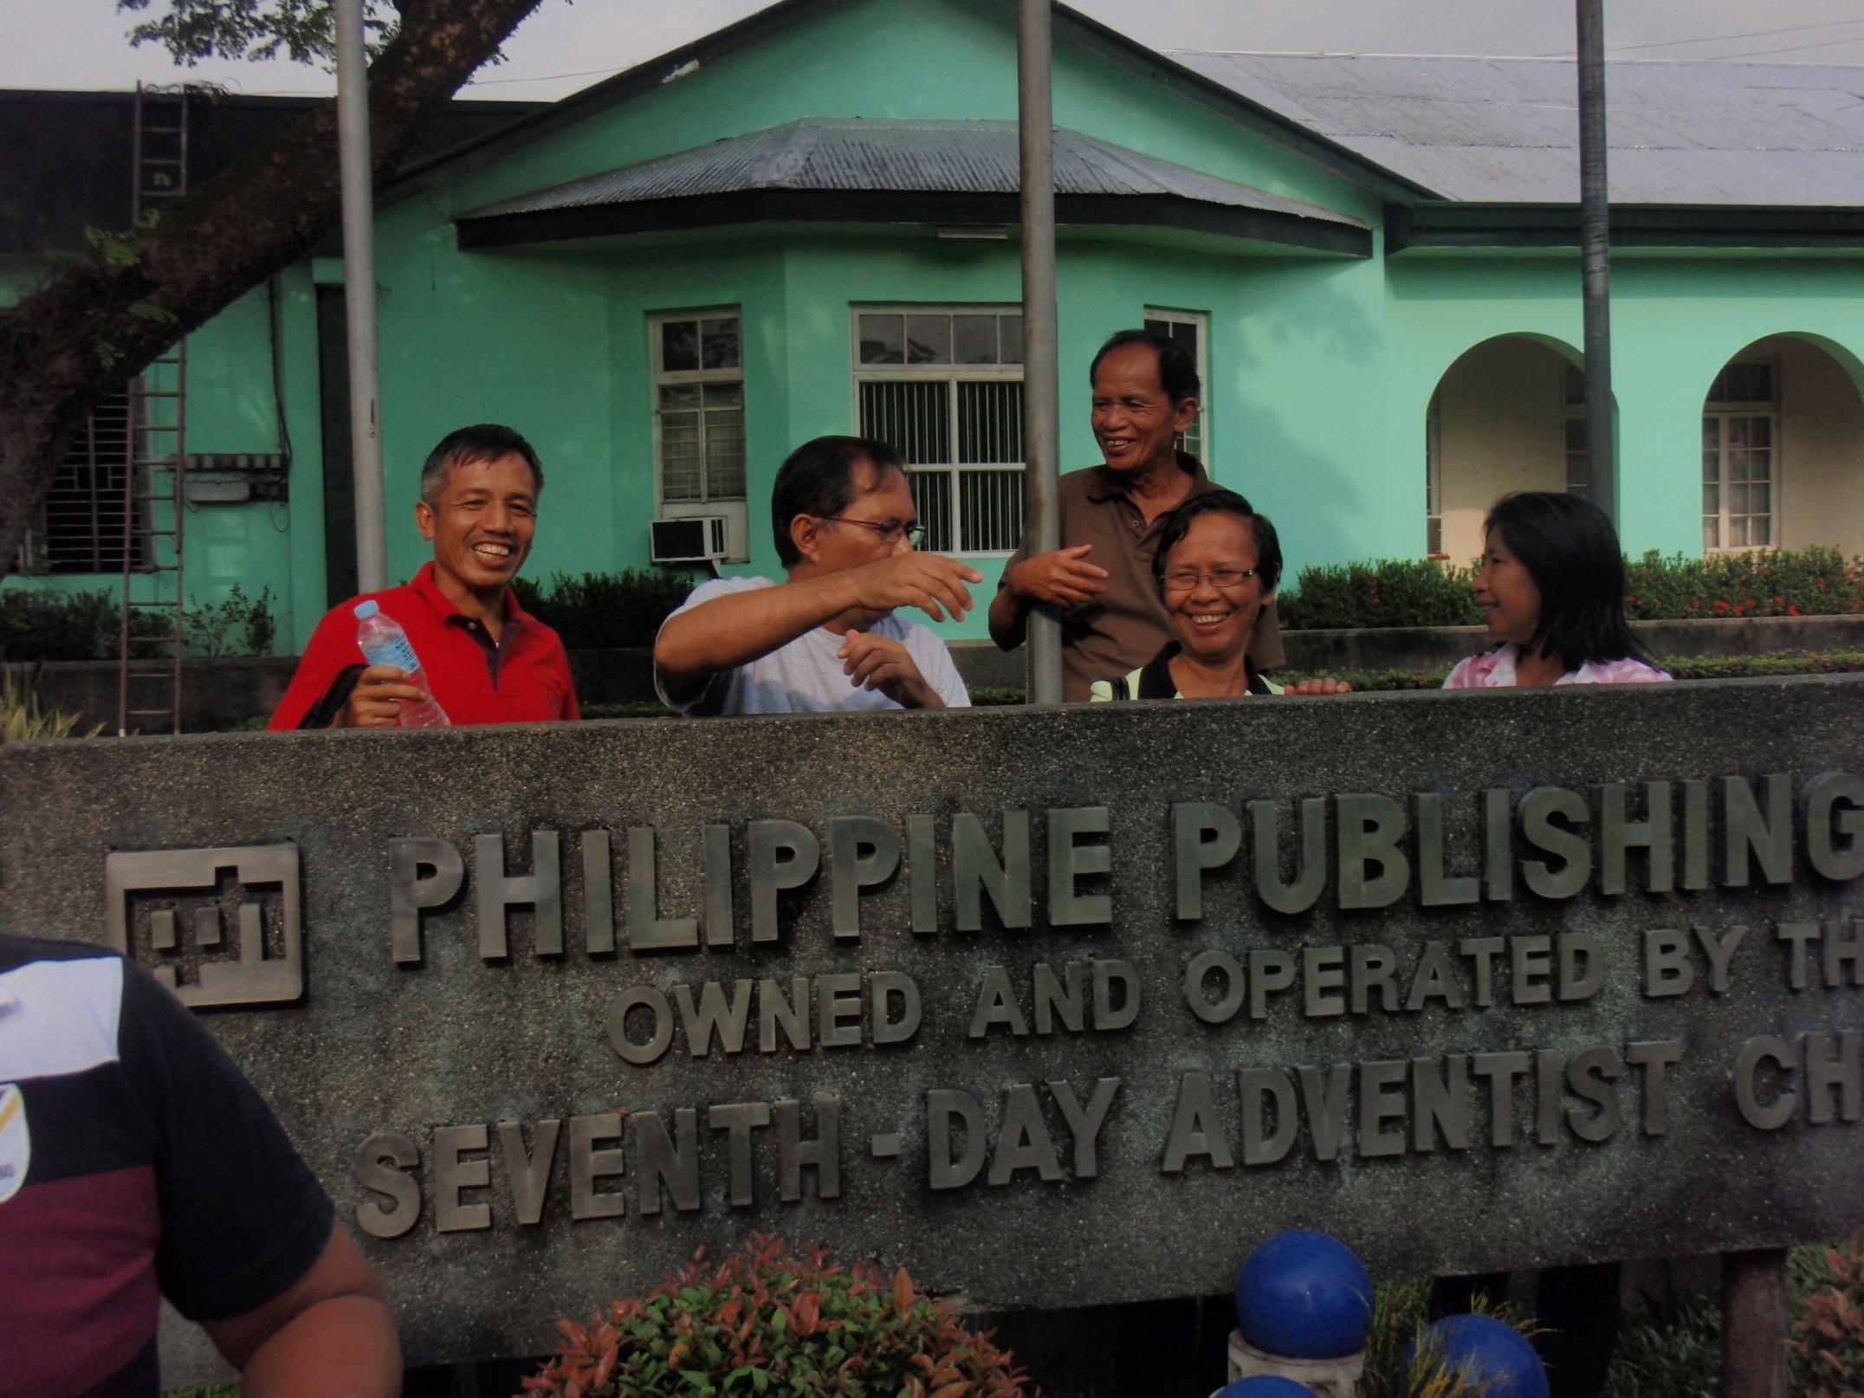

Slide 31
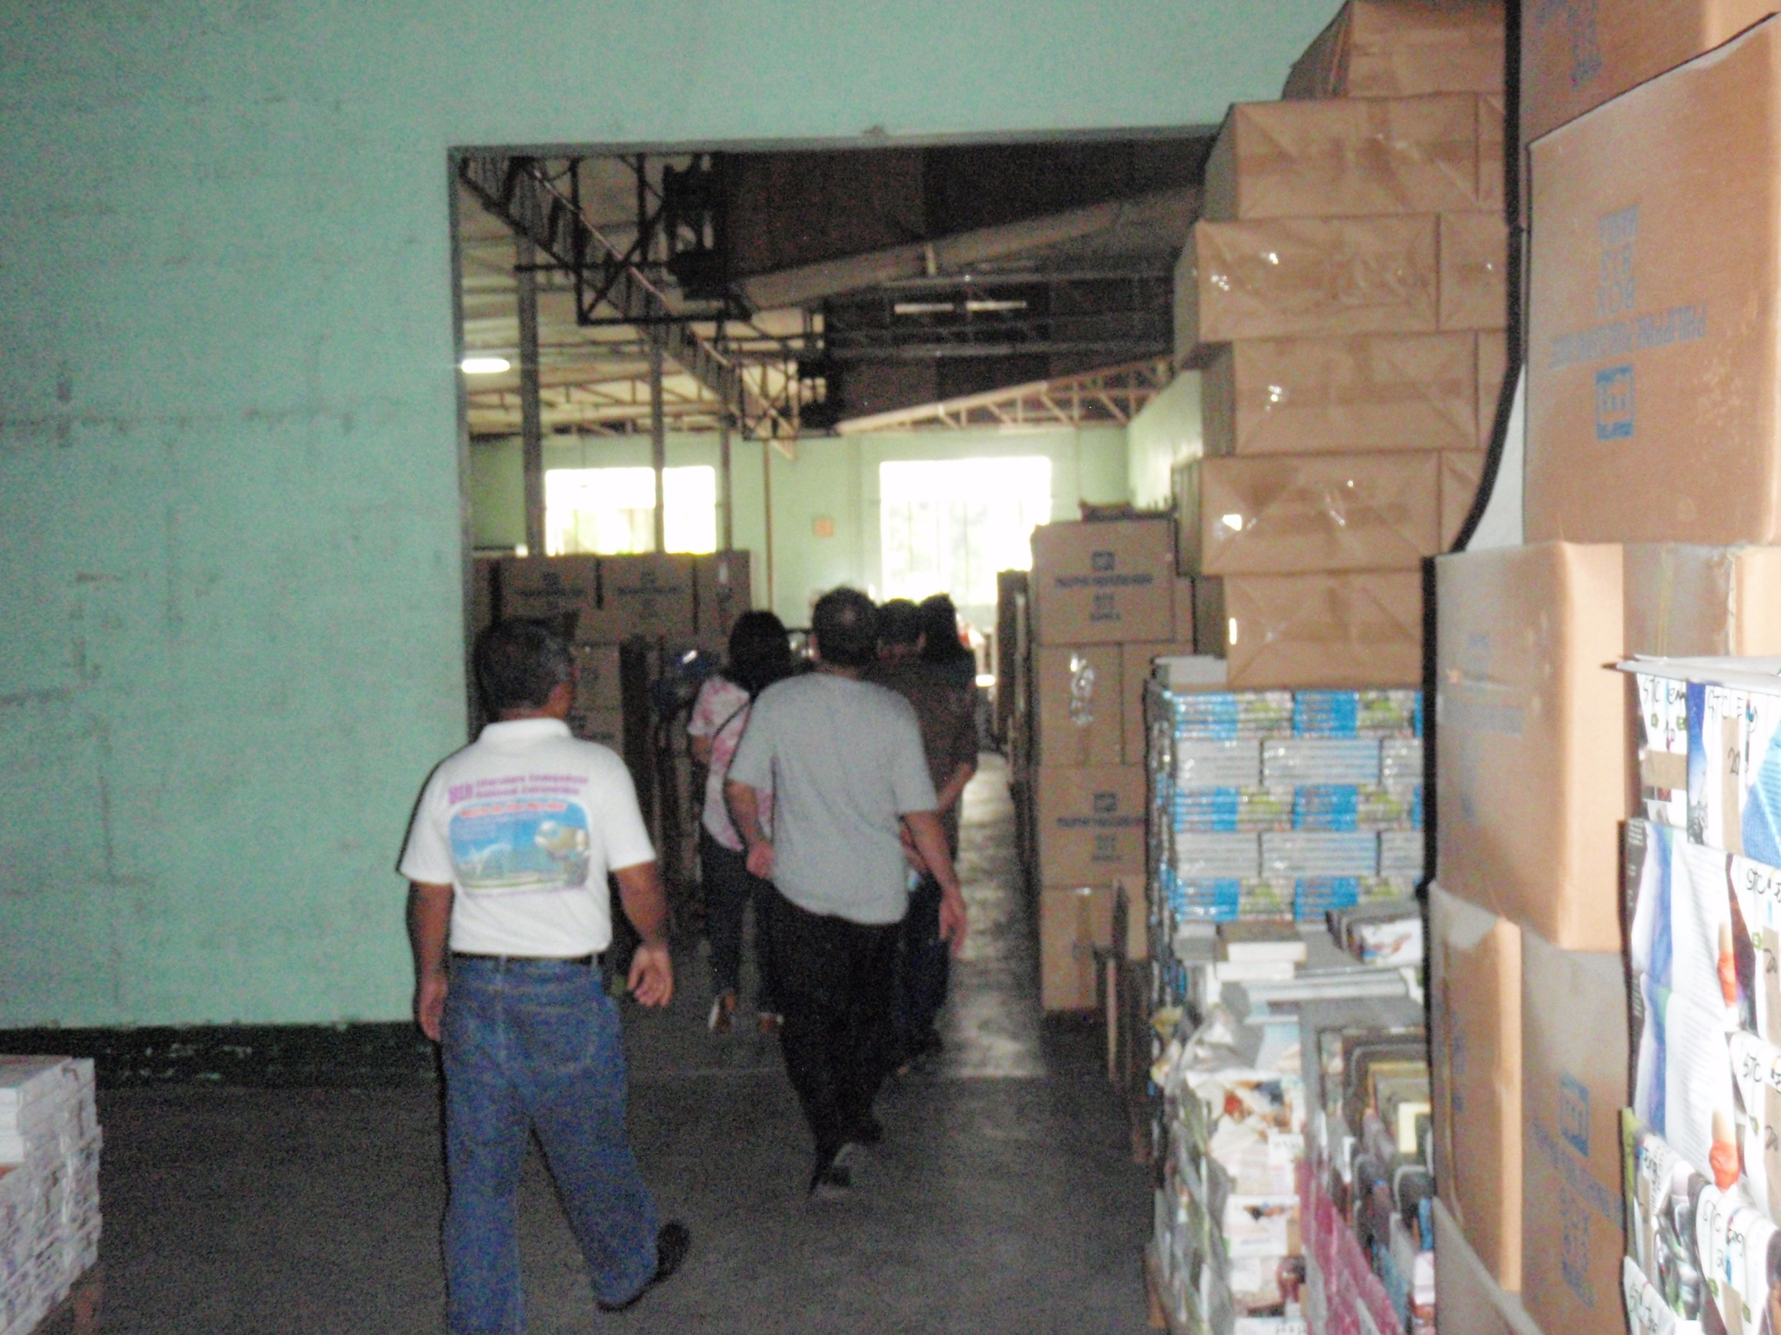

Slide 32
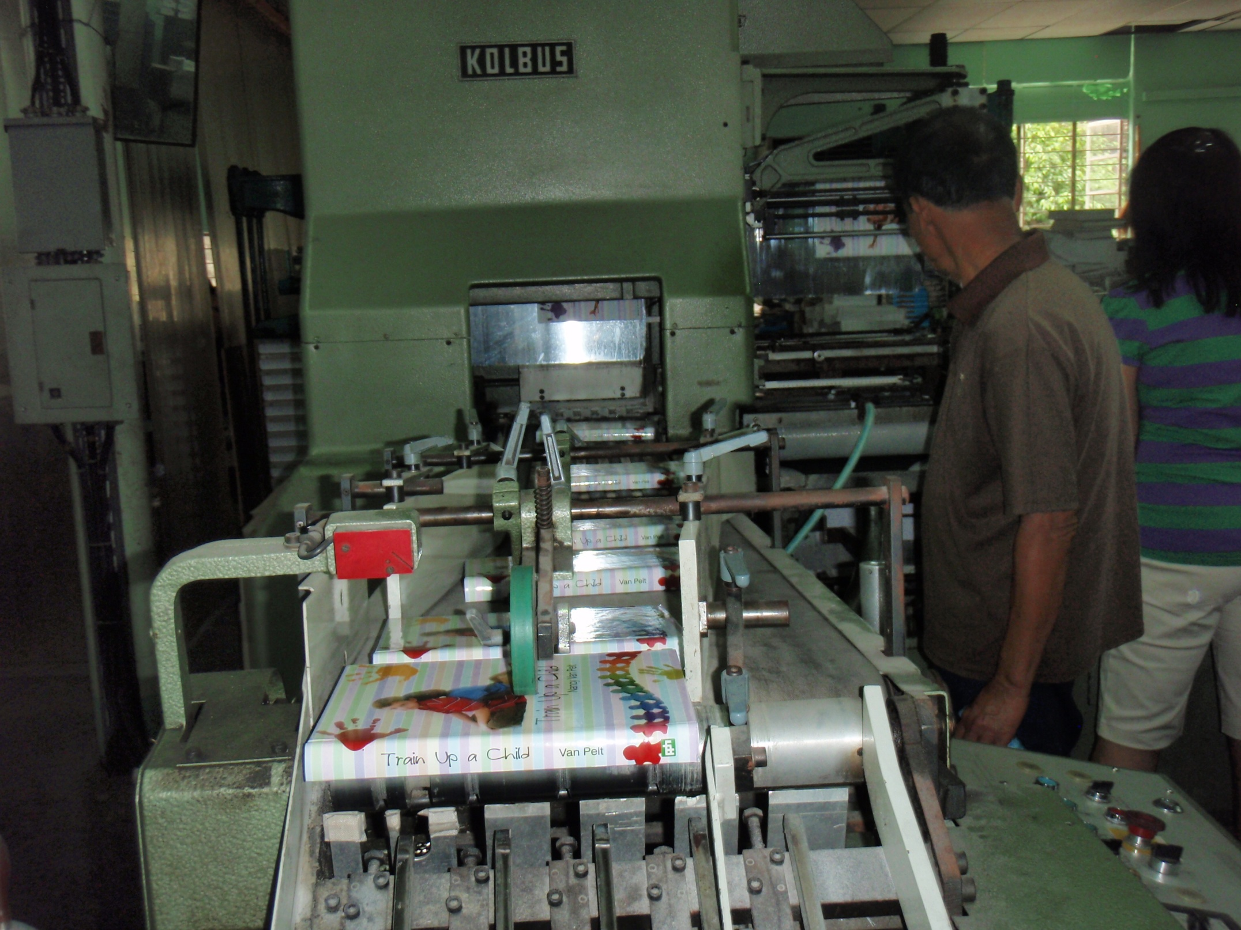

Slide 33
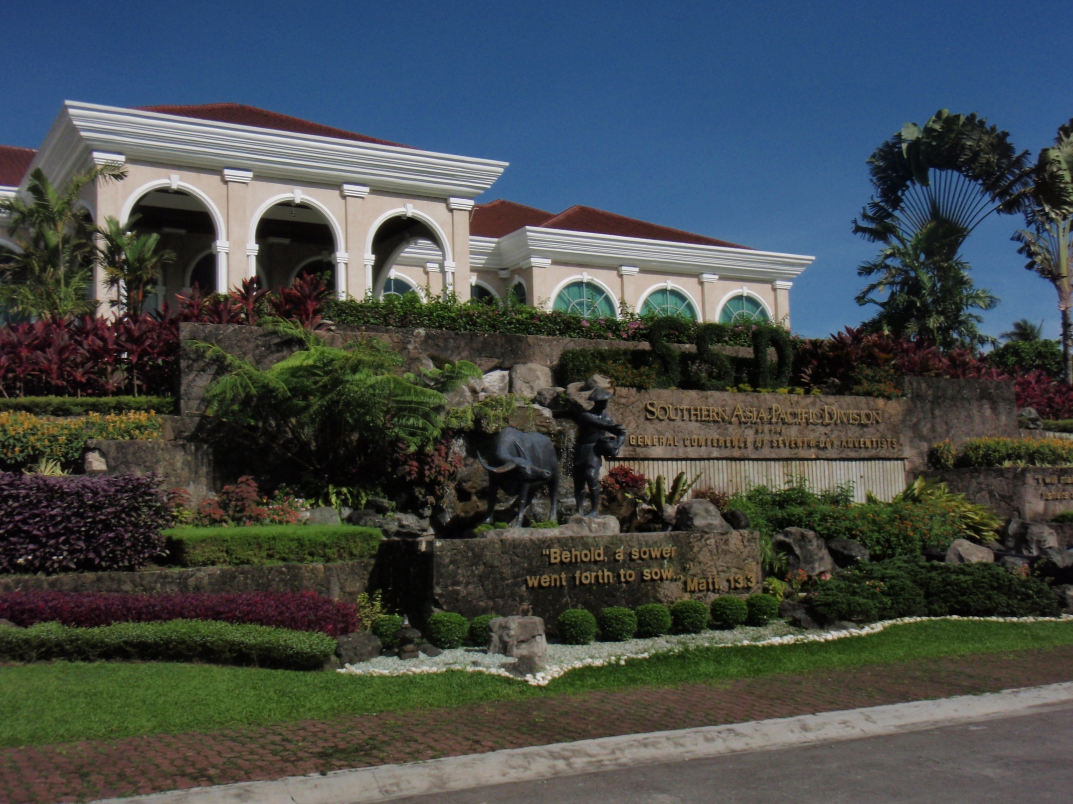

Slide 34
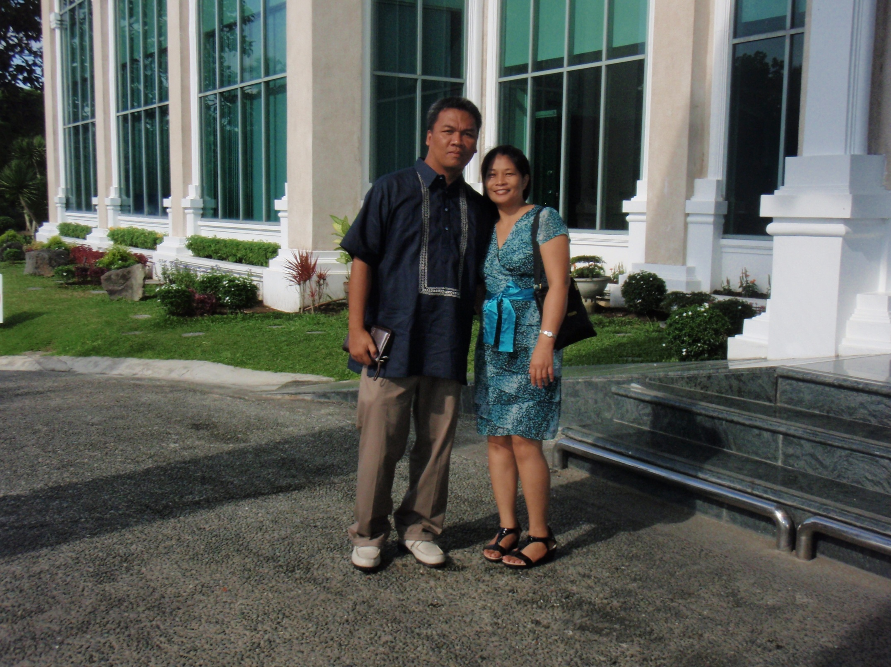

Slide 35
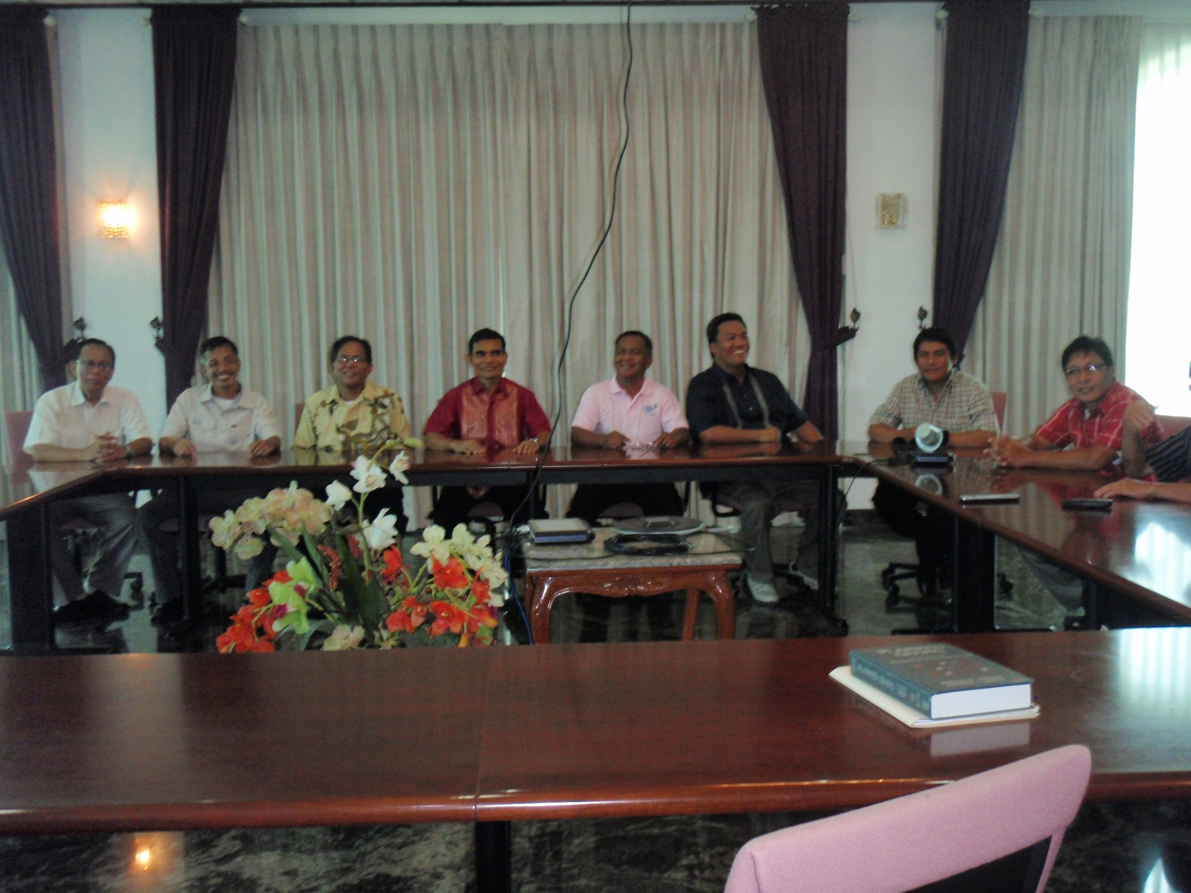

Slide 36
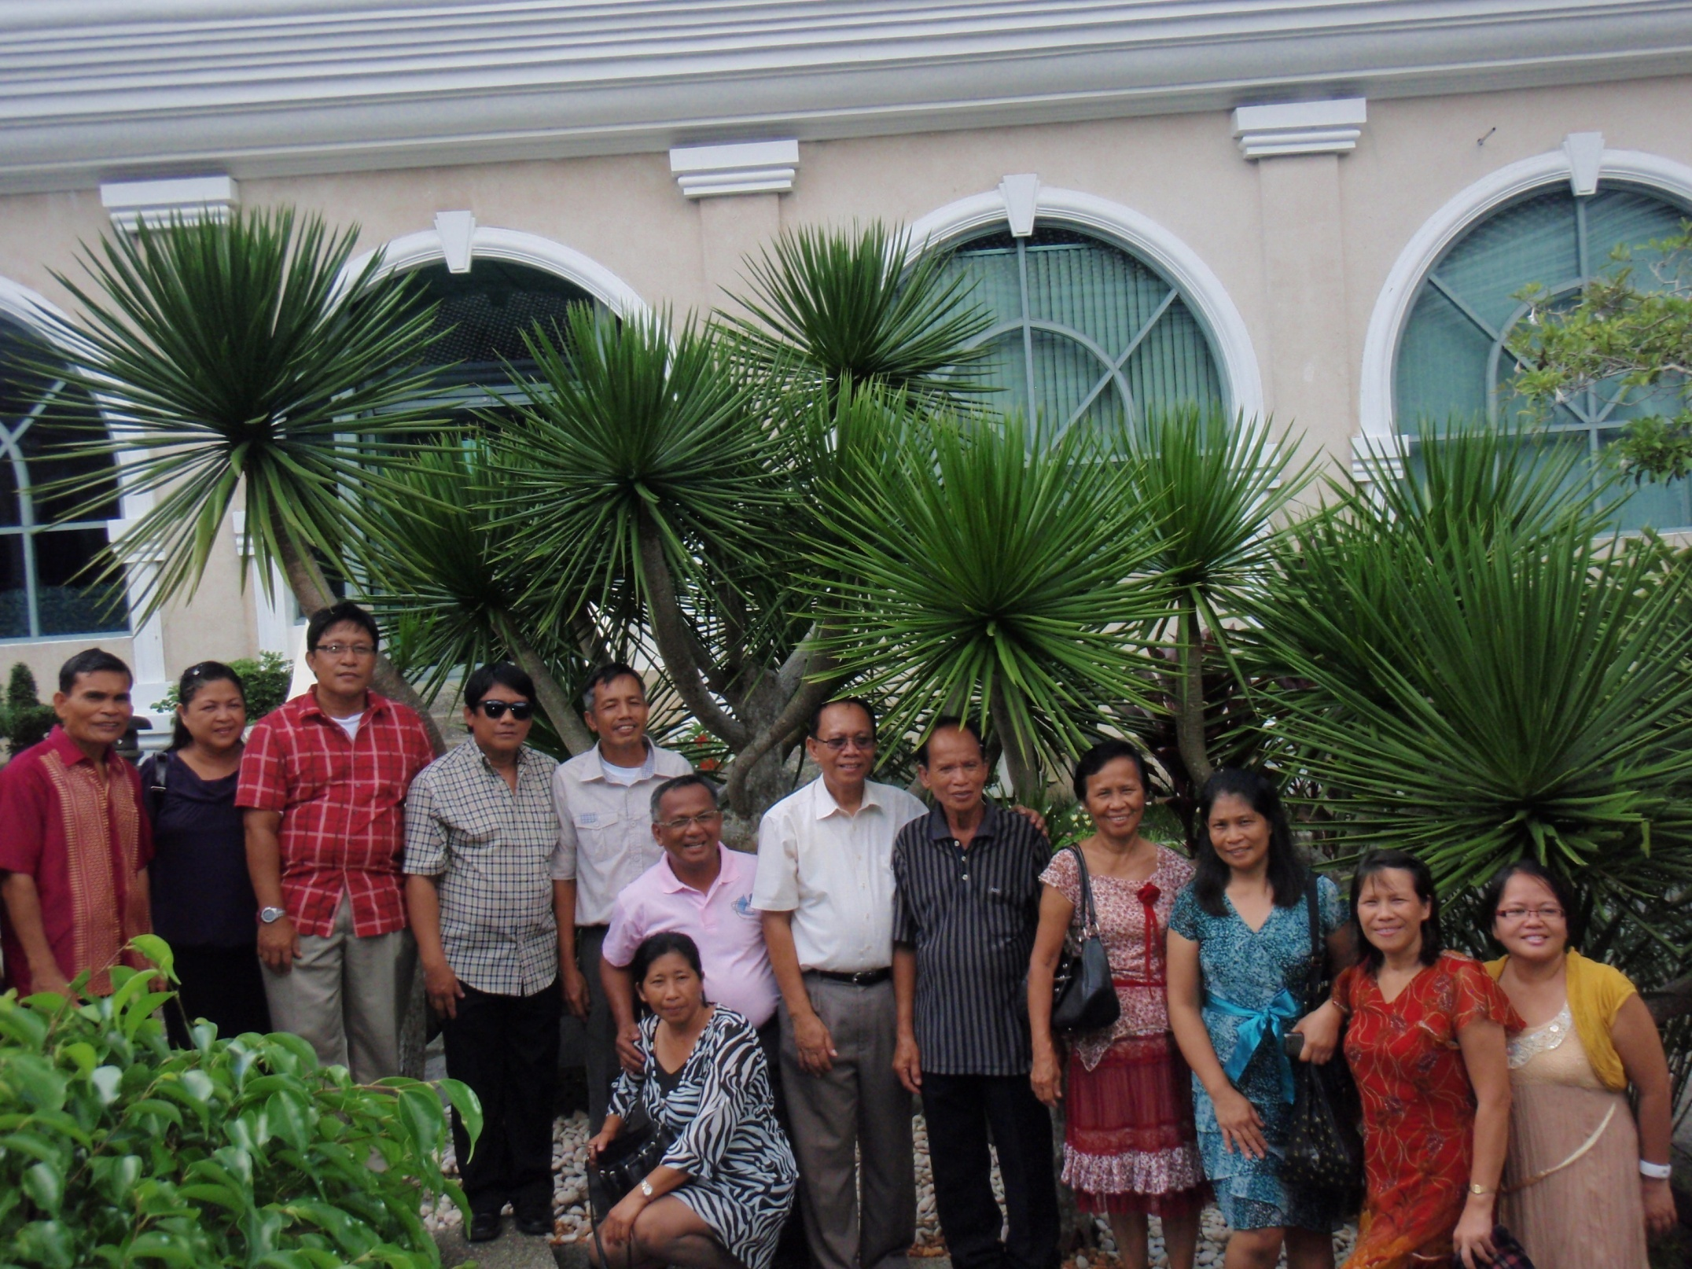

Slide 37
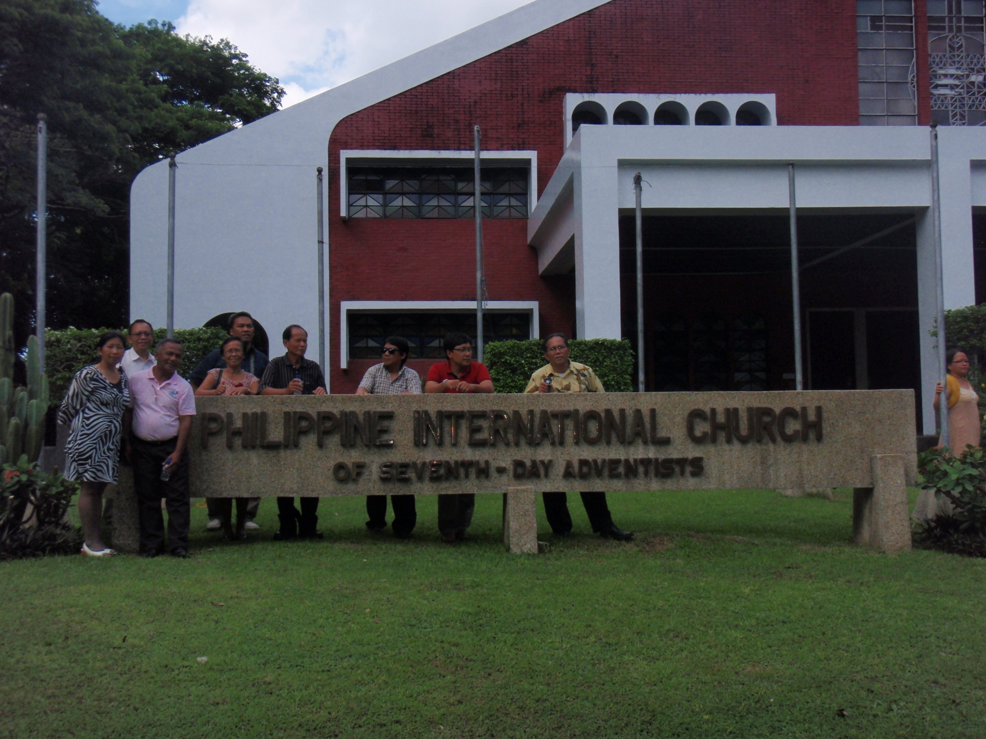

Slide 38
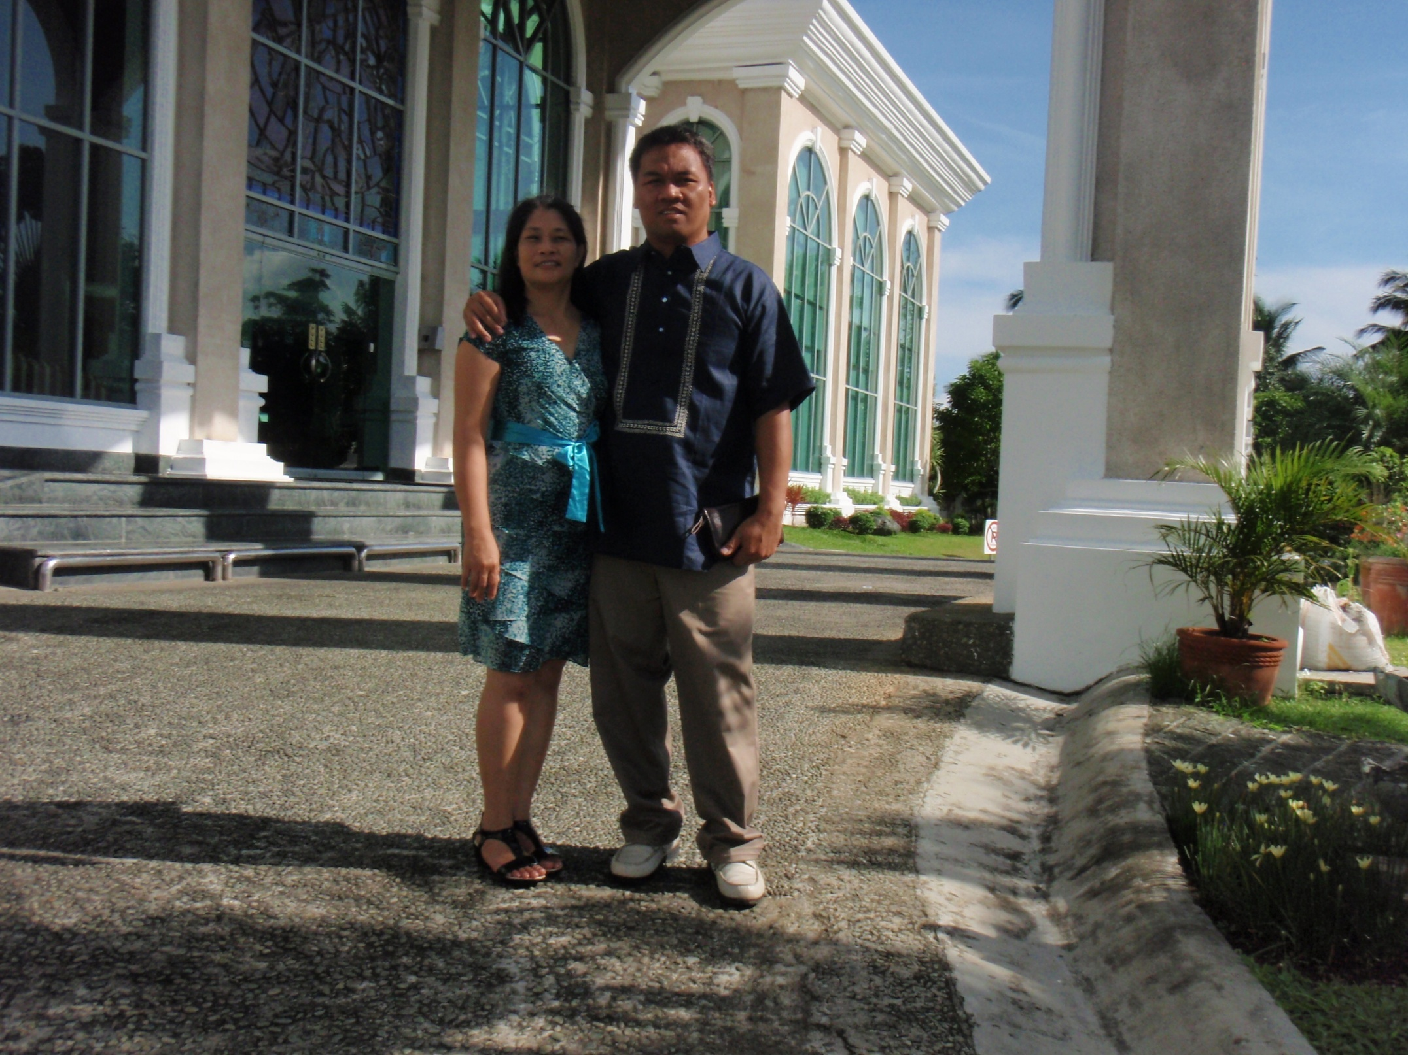

Slide 39


Slide 40
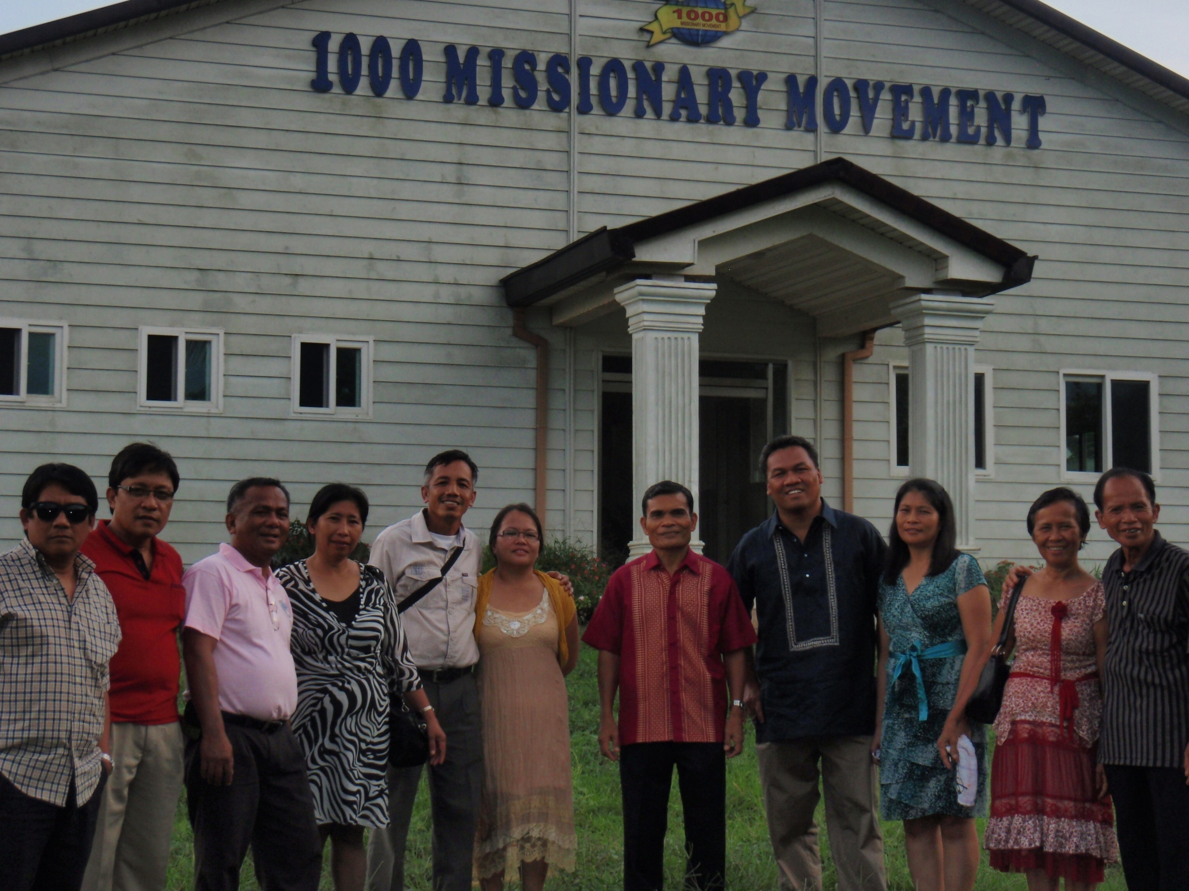

Slide 41
Temple City
Seventh-day Adventist Church
9664 East Broadway
Temple City, CA 91780
(626) 286-5437
The church is characteristically Laodicean. She “must realize (her) obligation to carry the gospel of present truth to every creature” (Christian Service, p. 111) if she avoids being “spewed out.”
THE
CONCEPT
3ABN
YMVC
Three Angels Broadcasting Network
YOUTH MEDIA VOLUNTERS CLUB

Slide 42
The ministers and church members should unite their efforts to proclaim the Lord’s message through any conceivable means because man is left with too little time to work.
THE
Grass Valley Seventh-day Adventist Church
12889 Osborne Hill Road
Grass Valley, CA 95945-8732
CONCEPT
3ABN
YMVC
Three Angels Broadcasting Network
YOUTH MEDIA VOLUNTERS CLUB

Slide 43
WEST TOWNSHED
Seventh-day Adventist Church
PO Box 1069 Route 30 West Townshend, VT
05359
As ministers, “the greatest help that can be given to our people is to teach them to work for God and to depend on Him, not on the ministers.” (7T, 19)
THE
CONCEPT
3ABN
YMVC
Three Angels Broadcasting Network
YOUTH MEDIA VOLUNTERS CLUB

Slide 44
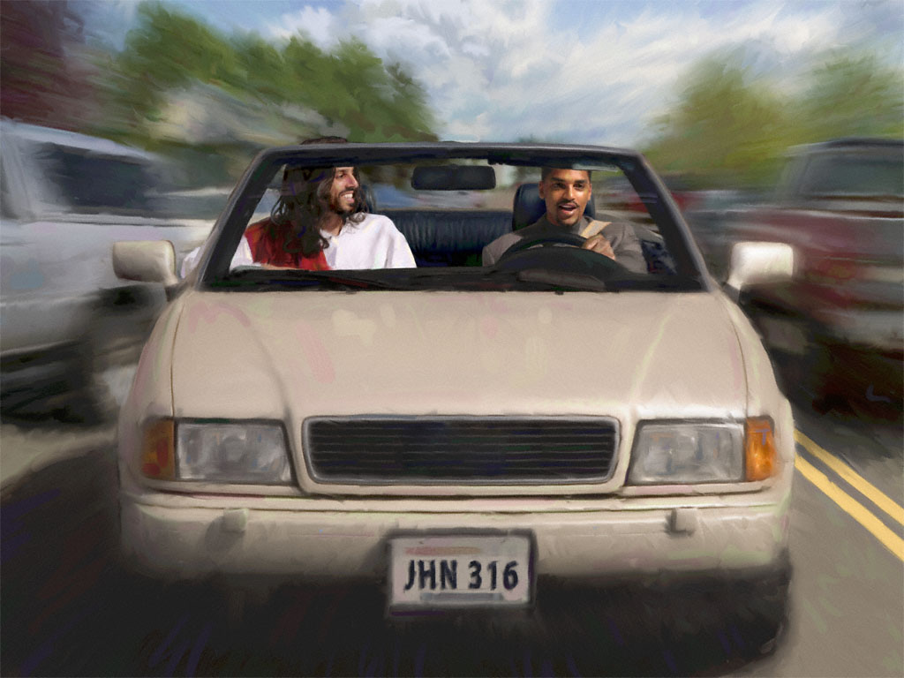

FRAMEWORKS
FRAMEWORKS
3ABN
YMVC
Three Angels Broadcasting Network
YOUTH MEDIA VOLUNTERS CLUB

Slide 45
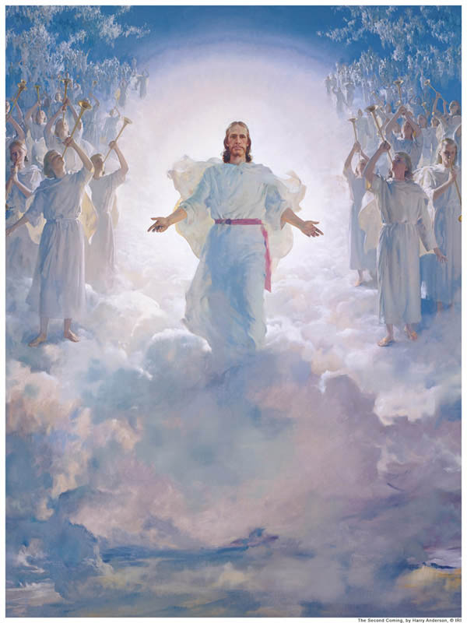
“To help prepare a people for the soon return of our Lord Jesus Christ, by utilizing all human and material resources for reaching the unreached, nurturing the believers in faith, and training them for Christian service, through the power of the Holy Spirit.” (Seventh-day Adventist Global Mission Statement)
“Every church should be a training school for Christian workers.” (Ministry of Healing, p. 14)
“The work of God in the earth will never be finished until men and women comprising our church membership rally to the work, and unite their efforts with those ministers and church officers.” (Gospel Workers, p. 352)

Slide 46
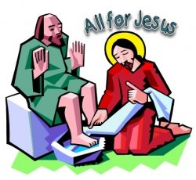
“He who begins with a little knowledge, in a humble way, and tells what he knows, while seeking diligently for further knowledge, will find the whole heavenly treasure awaiting his demand.” (Christ’s Object Lessons, p. 357)
“The greatest help that can be given to our people is to teach them to work for God, and to depend on Him, not on the ministers.” (7T, 19)
“The humblest workers, moved by the Holy Spirit, will touch invisible chords, whose vibrations will ring to the ends of the earth, and make melody through eternal ages.” (Desire of Ages, p. 827)

Slide 47
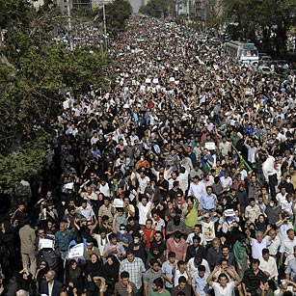

“If Christian were to act in concert, moving forward as one, under the direction of one Power, for the accomplishment of one purpose, they would move the world.” (9T, 221)
“The very simplest mode of the work should be devised and set in operation among the churches. If the members will unitedly accept such plans, and perseveringly carry them out, they will reap a rich reward; for their experience will grow brighter, their ability will increase, and through their efforts souls will be saved.” (6T, 433)
“Regardless of the high education of ministers and fantastic sermons, a very basic principle is … ‘we can receive only as we impart to others’.” (Desire of Ages, p. 370)

Slide 48
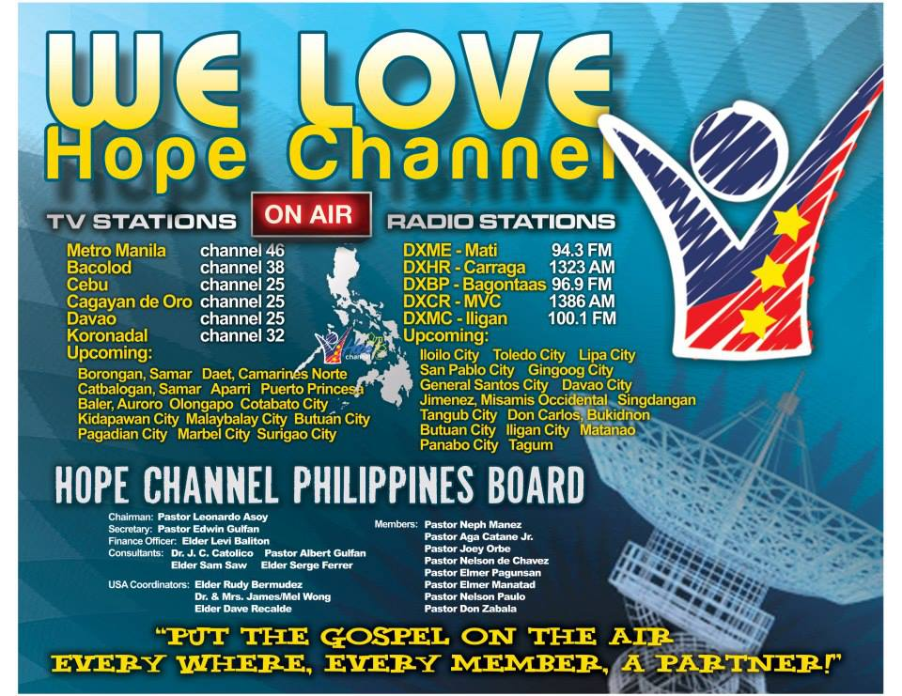
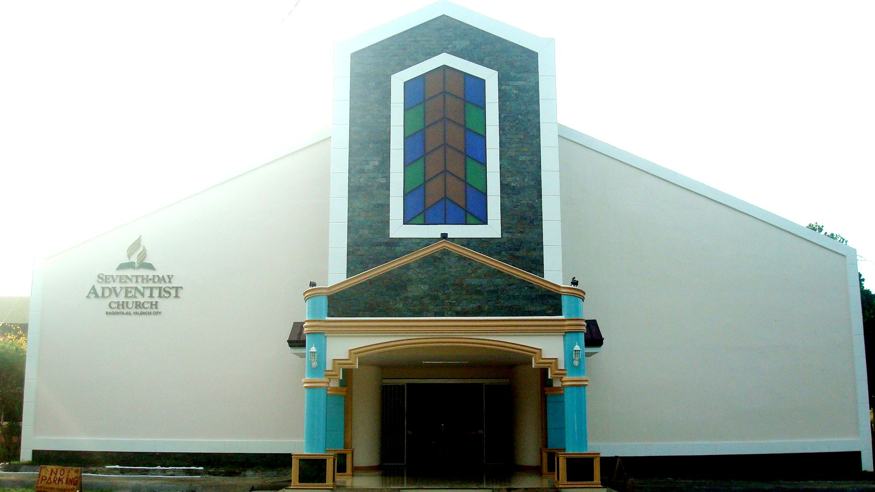
“The church must be a working church if it would be a living church.” (Christian Service, 83)
“The Latter Rain cannot come until the largest portion of the church [become] … laborers together with God.” (EGW, ___)
“Time is short and our forces must be organized to do a larger work,” (9T,27)

Slide 49
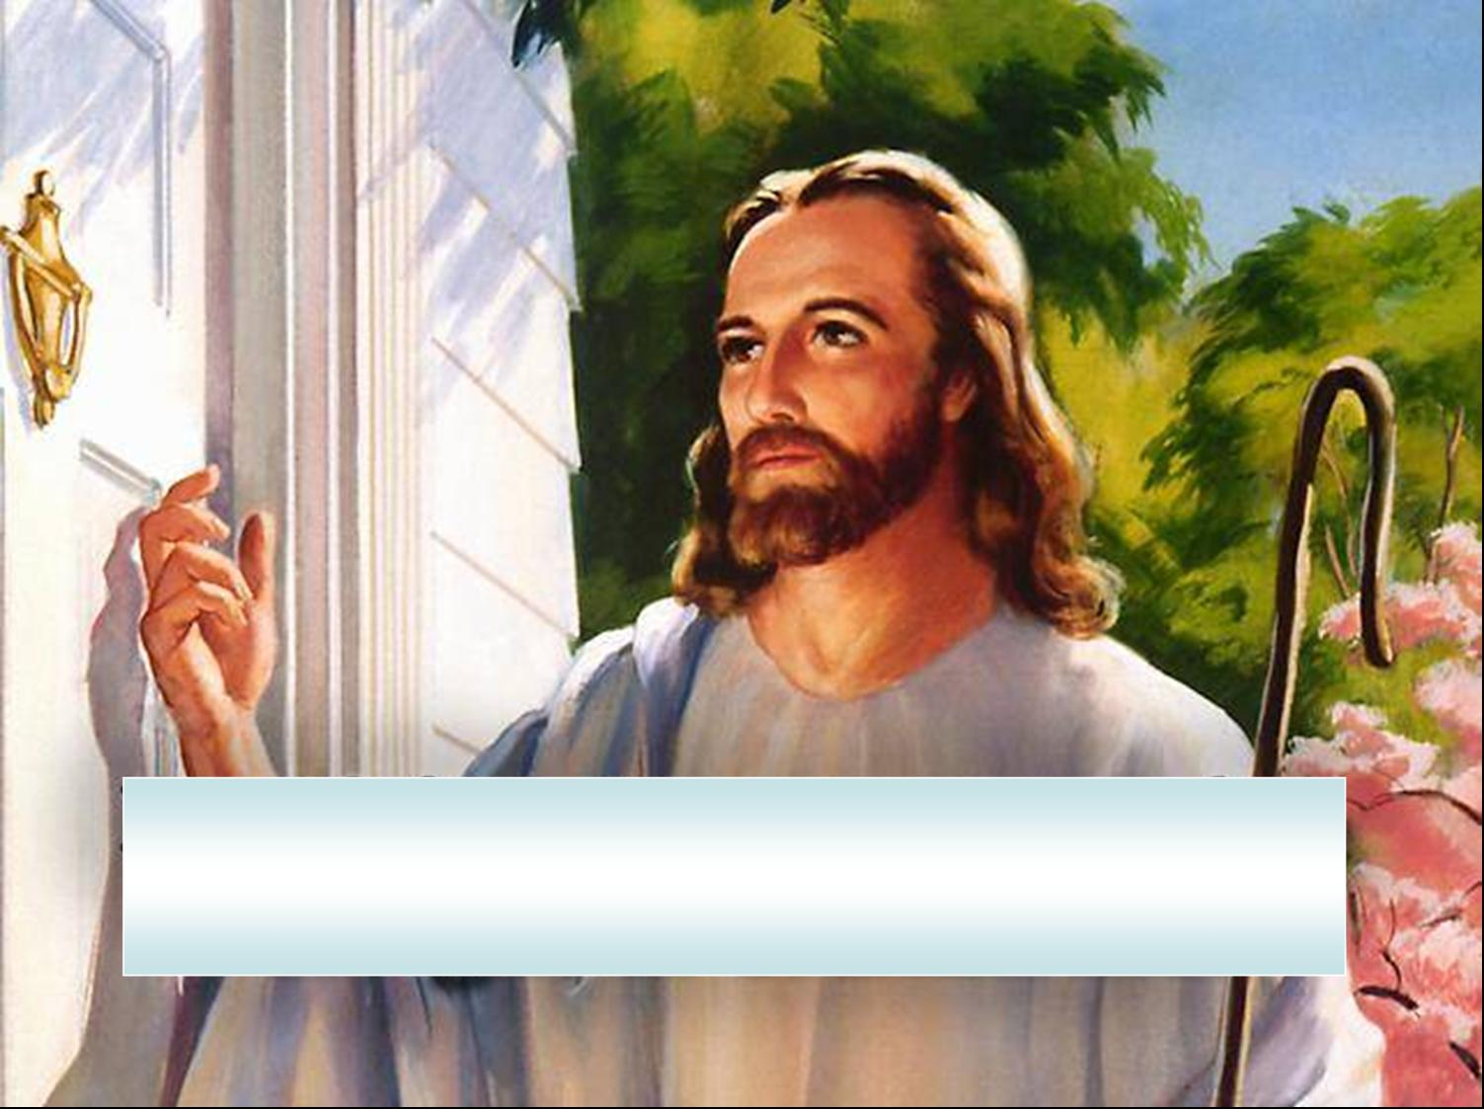

MISSION STATEMENT
3ABN
YMVC
Three Angels Broadcasting Network
YOUTH MEDIA VOLUNTERS CLUB

Slide 50

“The Seventh-day Adventist Church is a learning center where the radio and TV station can be used to prepare a people for the coming of the Lord.”
“The mission of the Seventh-day Adventist Church is to proclaim to all peoples the everlasting gospel in the context of the three angels’ messages of Revelation 14: 6 -12 using mass media, leading them to accept Jesus as personal savior and to unite with His church, and nurturing them in preparation for His soon return.”
MISSION
STATEMENT

Slide 51

WHY WEBSITE WITNESSING ?
3ABN
YMVC
Three Angels Broadcasting Network
YOUTH MEDIA VOLUNTERS CLUB

Slide 52
Christian service, p. 15 – it says: “the church is God’s appointed agency for the salvation of men. It was organized for service, and its mission is to carry the gospel to the world.”
General Conference Document: “The vital current of the church is evangelism; without it the church cannot exist. The church was organized to evangelize and its special mission is to carry the gospel to the worlds.”
Christian Service, p. 68 : “It is a fatal mistake to suppose that the work of soul-saving depends alone upon the minister.”
WHY WE
WITNESS

Slide 53


Christian Service, p. 11 – 12: “ …everyone who has received Christ is called to the work for the salvation of his fellow men.”
Christian Service, p. 68 : “The truth is to be scattered by all who claim to be Disciples of Christ.”
Christian Service, p. 11: “Men are instrument in the hand of God employed by Him, to accomplish His purpose of grace and mercy. Each has his part to act…”

Slide 54



Christian Service, p. 10: “Every soul whom Christ has rescued is called to work in His name for the saving of the lost.”

Slide 55
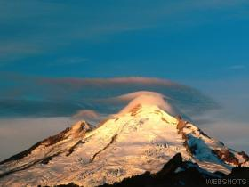
Gospel Workers, p. 352 : “The work of God in this earth can never be finished until the men and women comprising the church membership rally to the work and unite their efforts…”
Christian Service, p. 67: “Let the minister and lay members go fort into the ripening fields…”
GC Bulletin, February 28, 1893, p. 421: “Christian should unite with Christian, church with church, the human instrument with the Divine, and all should combine to give to the world the good news of the grace of god.”
FORMULA

Slide 56
Evangelism, p. 692 : “The truth is soon to triumph gloriously, and all who now choose to be laborers together with God will triumph with it all.”
Oswald J. Smith : “One generation will complete the work of evangelizing the world. Why not ours? Why leave this to another.”
We are the Lord’s by creation and redemption, we are His messengers in this Last generation.
FORMULA

Slide 57
“The church must be a working church if it would be a living church.” (Christian Service, 83)
“The Latter Rain cannot come until the largest portion of the church [become] … laborers together with God.” (EGW, ___)
“Time is short and our forces must be organized to do a larger work,” (9T,27)

Slide 58
VISIT OUR CHURCH WEBSITE
www.longvineradio.listen2myradio.com

Slide 59
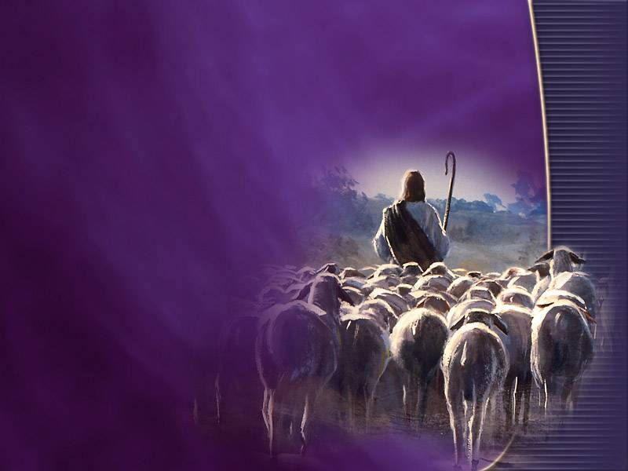
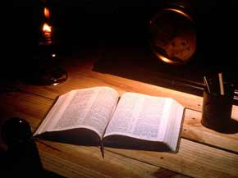
OBJECTIVES OF THE PROGRAM
OBJECTIVES
PROGRAM
of the
3ABN
YMVC
Three Angels Broadcasting Network
YOUTH MEDIA VOLUNTERS CLUB

Slide 60
To see to it that district-wide member-churches can vigorously participate synergistically.
To encourage church members to participate individually or collectively.
To bring about a unified support for evangelism both within the individual churches and district-wide territories.
To establish a stronger family-like relationship among church members.
To proclaim the gospel through a simple yet more dignified approach.
To experience the reality of partnership between the pastor and the laity in evangelism.
To revive the spirit of volunteerism in missionary work and liberalism in giving.
OBJECTIVES

Slide 61
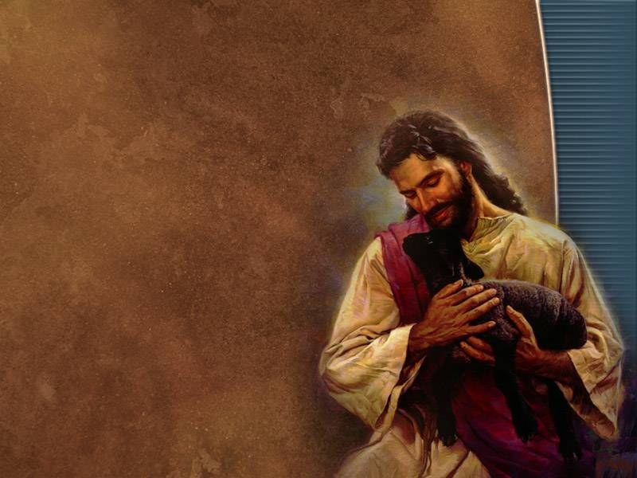

ASSUMPTIONS:
ASSUMPTIONS
3ABN
YMVC
Three Angels Broadcasting Network
YOUTH MEDIA VOLUNTERS CLUB

Slide 62
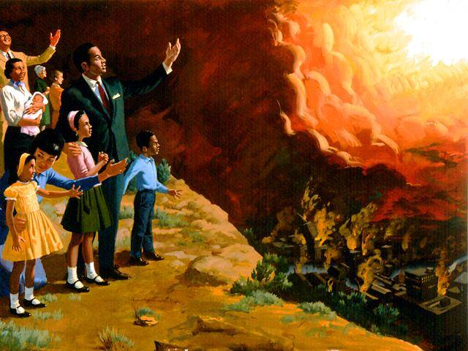
Bickering within the church is greatly reduced, if not totally eradicated.
Financial incapability's are no hindrance to church growth and membership participation in soul-winning.
Hasten the Lord’s coming.

Slide 63
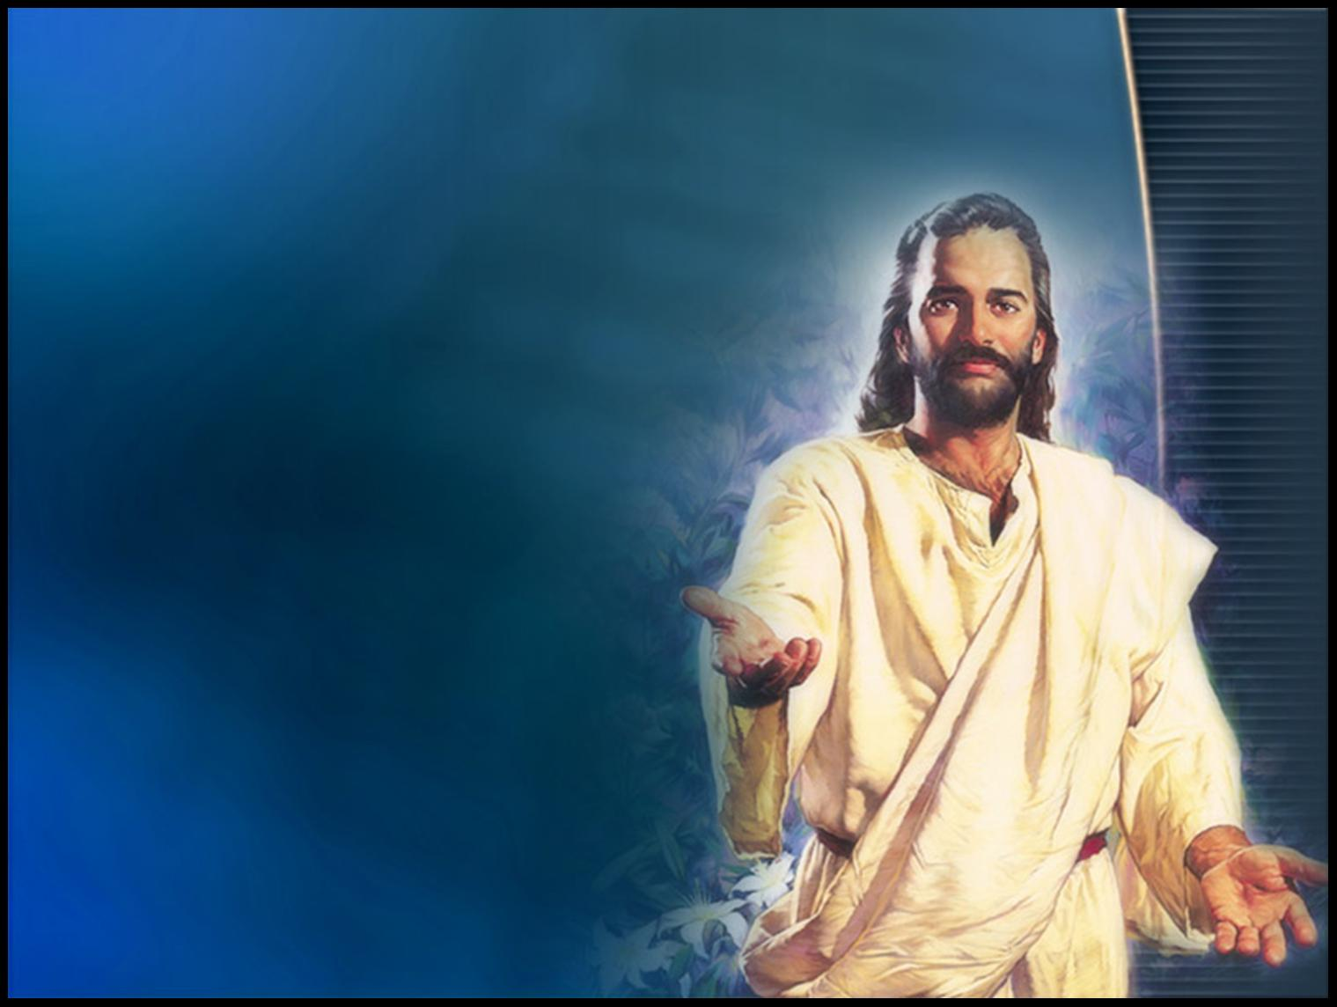
EXPECTED OUTCOMES
EXPECTED
OUTCOMES
3ABN
YMVC
Three Angels Broadcasting Network
YOUTH MEDIA VOLUNTERS CLUB

Slide 64
The whole church moves as one unified throng of lay workers.
Evangelism becomes an on-going program of the church.
A church-united force dwarfs the products of one or two full-time lay workers.
OUTCOMES

Slide 65
“The church must be a working church if it would be a living church.” (Christian Service, 83)
“The Latter Rain cannot come until the largest portion of the church [become] … laborers together with God.” (EGW, ___)
“Time is short and our forces must be organized to do a larger work,” (9T,27)

