Slide 1
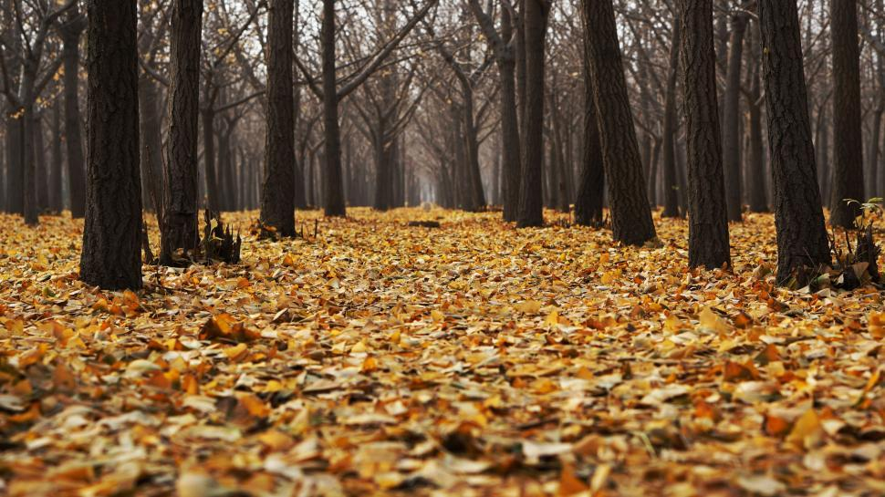
“Scatter books like leaves of autumn…”
—EGWhite, CM 25.
Notes:
God be praised!
Autumn leaves: The leaves are already on the ground, not on the trees.
The time is drawing fast. Soon, internet will be closed. TV will be closed. Radio will be closed. Public evangelism will be closed. Publishing ministry will be closed. PPH will be closed. But before that time comes, we have to make sure that our books are already placed in the homes as silent messengers who will supply spiritual in the time of famine of the Word of God.
Marami pa po tayong kailangang gawin. Maraming mga tao ang kailangang makarinig ng pabalita ng Dios sa sarili nilang mga wika. Muslims, Manobos, Aetas, Atis, and many others.
George King idea. (He originally wanted to be a preacher.)

Slide 2
Why Health and Home
1. Sustainable
Notes:
You can build a network of subscribers who will renew their subscription every year. Meaning, we will have a sustainable project source for any church project that we can have now or in the future.

Slide 3
Why Health and Home
1. Sustainable
2. New every year/current year of printing
Notes:
For people who are particular with the copyright, you can always be sure that the book you share is current/new every year.

Slide 4
Why Health and Home
1. Sustainable
2. New every year/current year of printing
3. Affordable
Notes:
The price is very minimal for a book of its kind, size, and content. The paper used is not ordinary paper but glossy. If liquid is accidentally spilled onto a page, you can easily wipe it off without smudging or destroying the paper.

Slide 5
Why Health and Home
1. Sustainable
2. New every year/current year of printing
3. Affordable
4. Open for anyone
Notes:
Regardless of gender, educational attainment, job/work—even students—love Health and Home. Jehovah’s Witnesses, Protestants, Catholics, Iglesia ni Cristo, Mormons, even Muslims love Health and Home.

Slide 6
Why Health and Home
1. Sustainable
2. New every year/current year of printing
3. Affordable
4. Open for anyone
5. Likable
Notes:
Fortunately, in its almost 70 years of existence (being the longest running health magazine in the country), Health and Home has already established a name and a reputation. Once nakasubscribe na ang customer, dili na masuko nganong nakapalit. Masuko na nganong nalaktawan og deliver or dugay nadeliveran sa sunod.

Slide 7
Why Health and Home
1. Sustainable
2. New every year/current year of printing
3. Affordable
4. Open for anyone
5. Likable
6. Evangelistic tool without prejudice
Notes:
Many have been converted to the truth because of Health and Home. Judge Mustafah Angeles c/o Pr. Nildo Mamac. There are doctors, lawyers, professors, etc. Because it is not directly doctrinal, and because it is perceived as an educational material, the truths inside Health and Home are openly received and studied by readers. They consider these truths as part of the article or part of the counsel for healthy and happy living. This is really the reason why we share Health and Home.

Slide 8
District Goal (2,000 copies)
Sellers/Sponsors | Copies per seller
300 | 7
250 | 8
200 | 10
150 | 13
100 | 20
80 | 25
50 | 40
40 | 50
30 | 67
20 | 100
Notes:
The more the sellers, the lesser the number of copies we need to sell/share. This must be a work of everyone. Even children should get involved because this is a mission project. United we stand, divided we fall. We might have better ideas but this is the time for us to just show our support to our leaders. We can sponsor out of our own pocket (from our savings or finding work to pay for our allotted share), we can sell, can ask someone else to sponsor.
Or we can divide the total 2,000 copies per churches and then divide to the number of church members. The more are involved, the easier the burden.

Slide 9
Deuteronomy 31:8
And the LORD, He is that doth go before thee; He will be with thee, He will not fail thee, neither forsake thee: fear not, neither be dismayed.

Slide 10
2 Kings 3:18
And this is but a light thing in the sight of the Lord: He will deliver the Moabites also into your hand.

