Slide 1


HAVE A NICE DAY
to
EVERYONE

Slide 2

SOTERIOLOGICAL & ESCHATOLOGICAL FOUNDATION OF LITERATURE
MINISTRY

Slide 3
Revelation 1:3 KJV
“Blessed is he who reads and those who hear the word of this prophecy, and keep those things which are written in it; for the time is near. ”

Slide 4
1 Timothy 2:4 KJV
“Who will have all men to be saved, and to come unto the knowledge of the truth.”

Slide 5
The 7s of the 777 = 77
In Revelation Chapters 2-3

Slide 6
7 Churches – 1:11
7 Golden
Lampstand 1:13
7 Stars – 1:16

Slide 7
Why = 77?

Slide 8
Revelation 1:20
“The mystery of the seven stars which you saw in My right hand, and the seven golden lampstand; The seven stars are the angels of the seven churches, and the seven lampstand which you saw are the seven churches.”

Slide 9
Why = 77?
7 Lampstands are Churches
7 Stars are Angels

Slide 10
Why
John was confused and afraid?
1:17

Slide 11
John saw the lampstand but the LIGHT is missing

Slide 12
7 significant words in 7 churches in Revelation

Slide 13
1 - 7 angels or stars, 1:20

Slide 14
1 - 7 angels or stars, 1:20
  2 - 7 write - Publish

Slide 15
1 - 7 angels or stars, 1:20
  2 - 7 write - Publish
  3 - 7 send - LE

Slide 16
1 - 7 angels or stars, 1:20
  2 - 7 write - Publish
  3 - 7 send - LE
  4 - 7 ears

Slide 17
1 - 7 angels or stars, 1:20
  2 - 7 write - Publish
  3 - 7 send - LE
  4 - 7 ears
  5 - 7 hear

Slide 18
1 - 7 angels or stars,
  2 - 7 write -
  3 - 7 send -
  4 - 7 ears
  5 - 7 hear
  6 - 7 overcome

Slide 19
1 - 7 angels or stars
  2 - 7 write
  3 - 7 send
  4 - 7 ears
  5 - 7 hear
  6 - 7 overcome
  7 - 7 assurance of salvation

Slide 22
“And when I saw him, I fell at his feet as dead. And he laid his right hand upon me, saying unto me, ‘Fear not; I am the first and the last:’” Revelation 1:17 KJV

Slide 23
John was trouble because he saw the lampstand but there was no light

Slide 24
Revelation 1:11
“I am Alpha and Omega, the first and the last: and, What thou seest, write in a book, and send it unto the seven churches which are in Asia; unto Ephesus, and unto Smyrna, and unto Pergamos, and unto Thyatira, and unto Sardis, and unto Philadelphia, and unto Laodicea.”

Slide 25
God set the book in the lampstand /church in order for her to shine

Slide 26
“Every page is a ray of light from heaven to
shine into the highways and the hedges, shedding light upon the pathway of truth.” CM 151

Slide 27



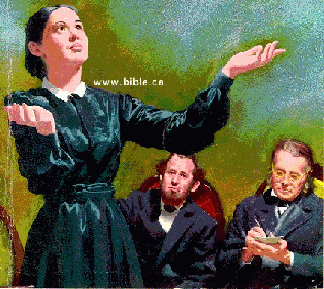

The church must give
her attention to the
canvassing work. This
is one way in which she is to shine
in the world. Then will she go forth
“fair as the moon, clear as the sun,
and terrible as an army with banners.” Manuscript 113, 1901.

Slide 29
Revelation 2:1, 7
1. Unto the angel of the church of Ephesus write:

Slide 30
Revelation 2:1, 7
1. Unto the angel of the church of Ephesus write:
7. Who overcomes – to eat the tree of life in Paradise of God

Slide 31
Revelation 2:8, 10-11
8 And unto the angel of the
church in Smyrna write:

Slide 32
Revelation 2:8, 10-11
8 And unto the angel of the
church in Smyrna write:
10 - “Be faithful until
death….”

Slide 33
Revelation 2:8, 10-11
11 - “…He who
overcomes shall not
hurt by the second
death.”

Slide 34
Revelation 2:12, 17
12 And unto the angel of
the church in Pergamos
write:

Slide 35
Revelation 2:12, 17
V 17 - Overcomers
- Can eat hidden manna
- Given white stone new
name written on it

Slide 36
Revelation 2:18, 25-26
18 And unto the angel of
the church in Thyatira
write:

Slide 37
Revelation 2:18, 25-26
Overcomers & keeps My works until the end
To him I will give power over the nations

Slide 38
Revelation 2:18, 25-26
How to keep My (God’s) work until the end?

Slide 39
Revelation 2:18, 25-26
Are there any hindrances for not keeping the work of God until the end?

Slide 40
Revelation 2:18, 25-26
Yes, there are

Slide 41
Revelation 2:18, 25-26
Censorship

Slide 42
Church Ministries Timeline

Slide 43
Church Ministries Timeline
Dorchester Vision
Publishing Ministry
1848

Slide 44
Church Ministries Timeline
Great Controversy Vision
Dorchester Vision
Publishing Ministry
1858
1848

Slide 45
Church Ministries Timeline
Great Controversy Vision
SDA Organized
Dorchester Vision
Publishing Ministry
1858
1861
1848

Slide 46
Church Ministries Timeline
Great Controversy Vision
SDA Organized
Dorchester Vision
Radio Ministry
Publishing Ministry
1858
1861
1848
1929

Slide 47
Church Ministries Timeline
Great Controversy Vision
SDA Organized
Dorchester Vision
Television Ministry
Radio Ministry
Publishing Ministry
1858
1861
1950
1848
1929

Slide 48
Church Ministries Timeline
Great Controversy Vision
SDA Organized
Dorchester Vision
Social Media Ministry
Television Ministry
Radio Ministry
Publishing Ministry
1858
1861
1950
1848
2000
1929

Slide 49
Church Ministries Timeline
Great Controversy Vision
SDA Organized
Dorchester Vision
Social Media Ministry
Television Ministry
Radio Ministry
Publishing Ministry
1858
1861
1950
1848
Present Time
2000
1929

Slide 50
Church Ministries Timeline
Great Controversy Vision
SDA Organized
Signs of 2nd Coming
Dorchester Vision
Social Media Ministry
Television Ministry
Radio Ministry
Publishing Ministry
1858
1861
1950
1848
Present Time
2000
1929

Slide 51
Church Ministries Timeline
Great Controversy Vision
SDA Organized
Signs of 2nd Coming
Dorchester Vision
Social Media Ministry
Television Ministry
Censorships
Radio Ministry
Publishing Ministry
1858
1861
1950
1848
Present Time
2000
1929

Slide 52
What is Censorship?
Defined & Translated

Slide 53
What is Censorship?
Defined & Translated
Suppression - Sumpuon
Control - Pugong
Cutting – Giputol

Slide 54
Unsay e Censor?
All channel of Evangelism
That needs permit or license
TV – Hope Channel
Radio– Hope Radio - AWR

Slide 55
Unsay e Censor?
- Evangelistic Effort
- Schools
- Hospitals
- Publishing Houses
- Bible Study

Slide 56
During CRISES
Censorship

Slide 57
Church Ministries Timeline
Great & Last Crisis
Great Controversy Vision
SDA Organized
Signs of 2nd Coming
Dorchester Vision
Social Media Ministry
Television Ministry
Censorships
Radio Ministry
Publishing Ministry
1858
1861
1950
1848
Present Time
2000
1929

Slide 58
What will happen during Crisis?

Slide 59
What will happen during Crisis?
Oppression of freedom
One day worship- Sunday
No Buying & Selling for God’s law abiding people

Slide 60
Revelation 3:7, 12
1 –And to the angel of the church in Sardis write:

Slide 61
Revelation 3:12
Overcomers
- White garment
- Names remained in the
Book of Life

Slide 62
Revelation 3:7, 12
And to the angel of the church in Philadelphia write:

Slide 63
Revelation 3:12
Overcomers
- Pilar in the temple of God
- Names written in New
Jerusalem

Slide 64
Revelation 3:14, 21
And to the angel of the church in Laodiceans write:

Slide 65
Revelation 3:14, 21
Overcomers
Granted to sit with
God in His throne.

Slide 66
What is God’s desire for His people during crisis?
All members of the church must be ACTIVE in evangelism

Slide 67
Active Involvement in Evangelism in the Last Days
Following a picture of the last CRISIS and events to take place in the closing scenes of earth’s history, several chapters are

Slide 68
devoted to the call for every Seventh-day Adventist to take an active part in evangelism, in home missionary work,

Slide 69
and in the circulation of literature.
9T 6.1

Slide 70
Active Involvement in Evangelism in the Last Days
active part in evangelism, in home missionary work,
and in the circulation of literature. 9T 6.1

Slide 71
Pastor’s Role

Slide 72

When we follow plans of the Lord's devising "we are laborers together with God." Whatever our position--whether presidents of conferences, ministers, teachers, students, or lay members we are held
accountable by the Lord for making the most of our opportunities to enlighten those in need of present truth

Slide 73
- presidents of conferences
- ministers
- teachers
- students
- lay members
Whatever Our Position Whether
we are held accountable by the Lord for making the most of our opportunities to enlighten those in need of present truth

Slide 74
and one of the principal agencies He has ordained for our use is the printed page. In our schools and
sanitariums, in our home churches, we must learn to make a wise use of this precious agency. 9T 86, 87

Slide 75
“Canvassing for our publications is an important and most profitable line of evangelistic work.”
CCh 72.3

Slide 76
A Most Precious Ministry
“I have been shown that the most precious ministry can be done by canvassing, and that by ministers.”
TM p. 317.2

Slide 77
Ministers to Help Recruit Canvassers
“We shall call upon our ministers as they visit the churches to encourage men and women to go out as canvassers….”
Manuscript 10, 1900. PM 275.

Slide 78
Church Ministries Timeline
Great & Last Crisis
Great Controversy Vision
SDA Organized
Signs of 2nd Coming
Dorchester Vision
Social Media Ministry
Television Ministry
Censorships
Radio Ministry
Publishing Ministry
Literature Ministry
1858
1861
1950
Present Time
Truth filled Books
1848
2000
1929

Slide 79
Church Ministries Timeline
Great & Last Crisis
Great Controversy Vision
SDA Organized
Signs of 2nd Coming
Dorchester Vision
Social Media Ministry
Television Ministry
Censorships
Plague
Radio Ministry
Publishing Ministry
Literature Ministry
1858
1861
1950
Present Time
Truth filled Books
1848
2000
1929

Slide 80
Church Ministries Timeline
Great & Last Crisis
Great Controversy Vision
SDA Organized
Signs of 2nd Coming
Dorchester Vision
Social Media Ministry
Television Ministry
Censorships
Plague
Radio Ministry
Publishing Ministry
Literature Ministry
1858
1861
1950
Present Time
Truth filled Books
1848
Close Probation
2000
1929

Slide 81
Church Ministries Timeline
Great & Last Crisis
Great Controversy Vision
Signs of 2nd Coming
2nd Coming
SDA Organized
Dorchester Vision
Social Media Ministry
Television Ministry
Censorships
Plague
Radio Ministry
Publishing Ministry
Literature Ministry
Eternity
1858
1861
1950
Present Time
Truth filled Books
1848
Close Probation
2000
1929

Slide 82
Reason Why We Need to Sell or Give-away Books
For us to be Overcomers

Slide 83
“In working for perishing souls, you have the companionship of angels. Thousands upon thousands, and ten thousand times ten

Slide 84
thousand angels are waiting to co-operate with members of our churches in communicating the light that God has generously

Slide 85
given, that a people may be prepared for the coming of Christ.”
Testimonies for the Church 9:129. ChS 259.1

Slide 86
“Thousands upon thousands & 10,000 x 10,000 of angels”
2,000 x 2,000 = 4,000,000
10,000 x 10,000 = 100,000,000
Total + 104,000,00 more or less

Slide 87
Total = 104,000,000 angels waiting for you

Slide 88
Waldensians’ faith amidst of persecution

Slide 89
1,700 slaughtered of the waldensians
This massacre became known as the Piedmont Easter. An estimate of some 1,700 Waldensians were slaughtered; the massacre was so brutal it aroused indignation throughout Europe.
"Milton: Sonnet 18". Dartmouth.edu. Retrieved 26 February 2014.

Slide 90
Wesleyan Methodist Missionary Society - https://books.google.com.au/books?id=glwEAAAAQAAJ&printsec=frontcover&source=gbs_ge_summary_r&cad=0#v=onepage&q&f=false
Piedmontese Children Forced from their parents (October 1853, X, p.108)

Slide 91
Wesleyan Methodist Missionary Society - https://books.google.com.au/books?id=glwEAAAAQAAJ&printsec=frontcover&source=gbs_ge_summary_r&cad=0#v=onepage&q&f=false
Piedmontese Children Forced from their parents (October 1853, X, p.108)

Slide 92
In 1655, Anna was Tortured
Print illustrating the 1655 massacre in La Torre, from Samuel Moreland's History of the Evangelical Churches of the Valleys of Piedmont, published in London in 1658
Samuel Moreland - Samuel Moreland "History of the Evangelical Churches of the Valleys of Piedmont", p.345.
This image is among a group of prints illustrating the massacre of the Waldenses which took place in 1655. The young woman being tortured is said to be Anna, daughter of Giovanni Charboniere of La Torre.

Slide 94
Why Waldensians stood in their faith amidst of persecution?

Slide 95
Waldensians keep on USING printED books/bible
The Waldensian movement was characterized from the beginning by lay preaching, voluntary poverty, and strict adherence to the Bible. Between 1175 and 1185, Waldo either commissioned a cleric from Lyon to translate the New Testament into the vernacular—the Arpitan (Franco-Provençal) language ^{[21]}—or was himself involved in this translation work.
21 HARRIS, M. Roy. Old Waldensian: Some linguistic and editorial observations. Romance Philology, v. 38, n. 2, p. 200-225, 1984.

Slide 96
According Demsky, (2018) “the Waldensian… traveled through Europe spreading the gospel. They traveled by twos, disguised as merchants, many times selling fine silks and jewels.
Demsky, K. (2018). The Waldenses: Historical Perspectives

Slide 97
As they had opportunity they discreetly brought parts of scripture or small bibles and tracts out of their clothing to
Demsky, K. (2018). The Waldenses: Historical Perspectives

Slide 98
share with interested purchasers. This was a risk because it was against the law on pain of death to do share these gospel writings.”
Demsky, K. (2018). The Waldenses: Historical Perspectives

Slide 99
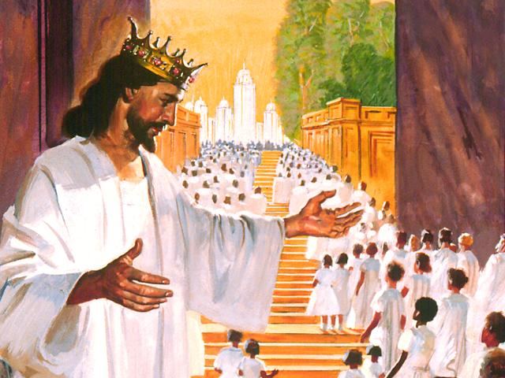
*
Notes:
And you think, this is so wonderful admiring these mansions, I could spend the next 1000 years just looking at these mansions with Jesus. And then I can just imagine that as you’re walking along with Jesus, you spot up ahead a mansion that really catches your fancy. And you think to yourself; of all the mansions I’ve seen, I like that one the best. That just fits my style. I wonder who lives in that mansion? And I can imagine that as you come to that long winding walkway that leads up to that mansion, Jesus stops.

Slide 100
Photo credit to pinterest.com

Slide 102
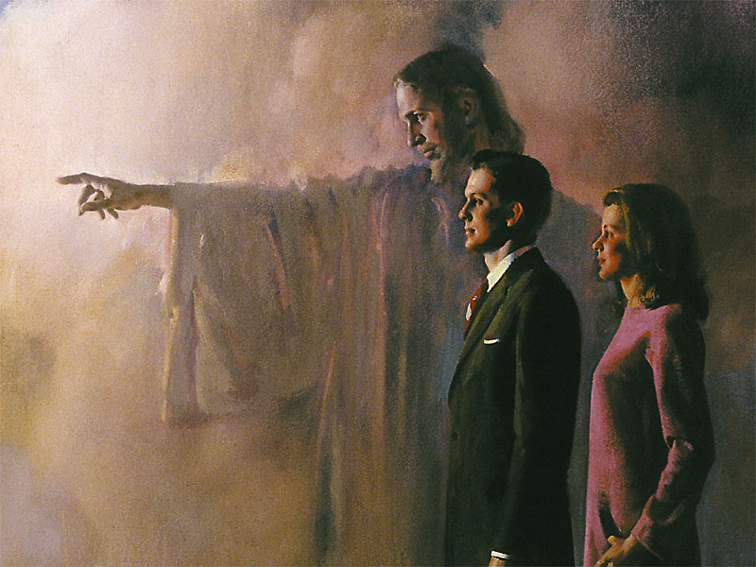
“The Lord Jesus standing by the side of the canvasser

Slide 103
“The Lord Jesus standing by the side of the canvasser
is the chief
Worker”
CM 40 (1902)

Slide 104
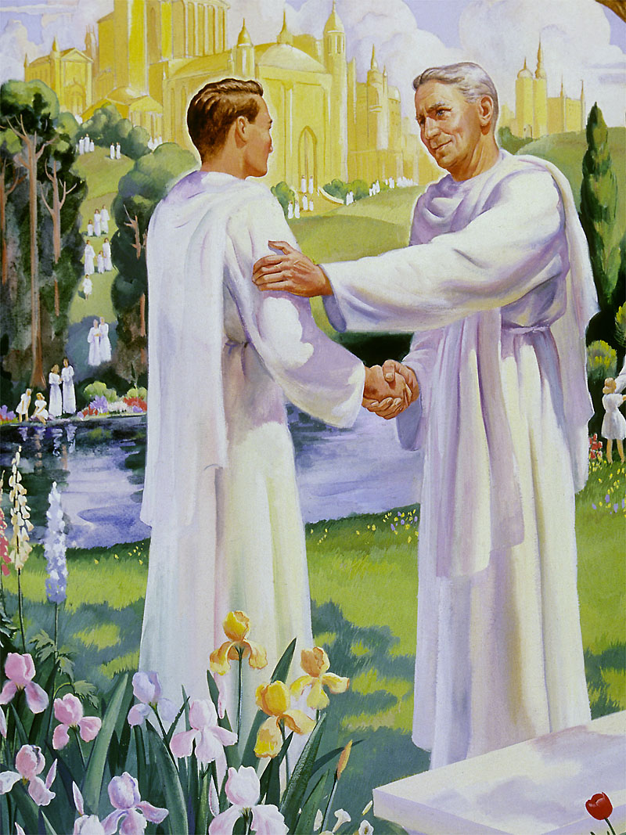
Thank you very much

Slide 105
Thank you very much
Welcome Sir, but,

Slide 106
Thank you very much
Welcome Sir, but, I’m sorry I forgot, where did I meet you.

Slide 107
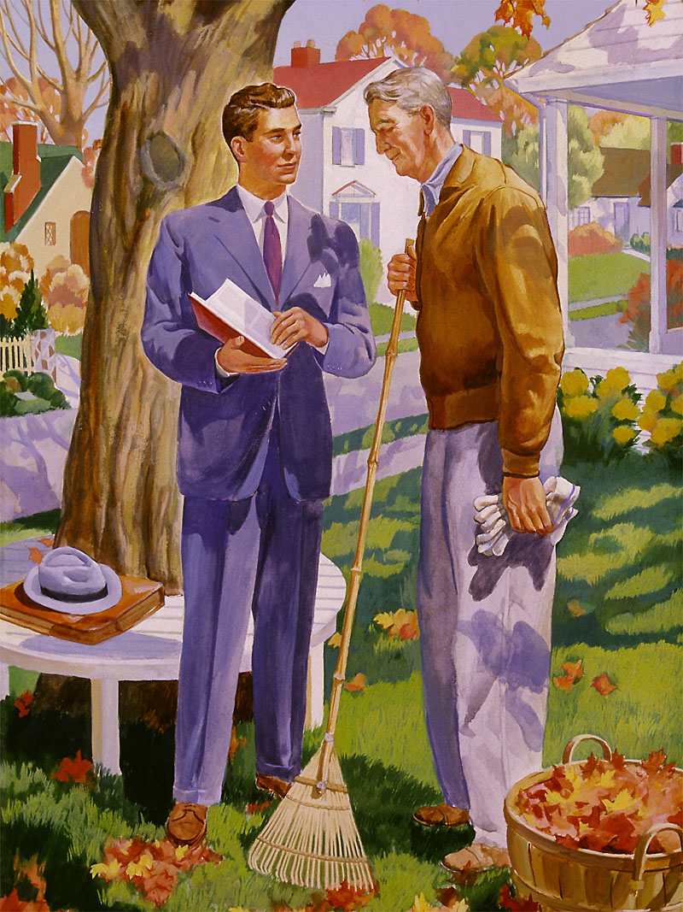

Slide 108
You are the one who invited me here, thank you so much

Slide 110
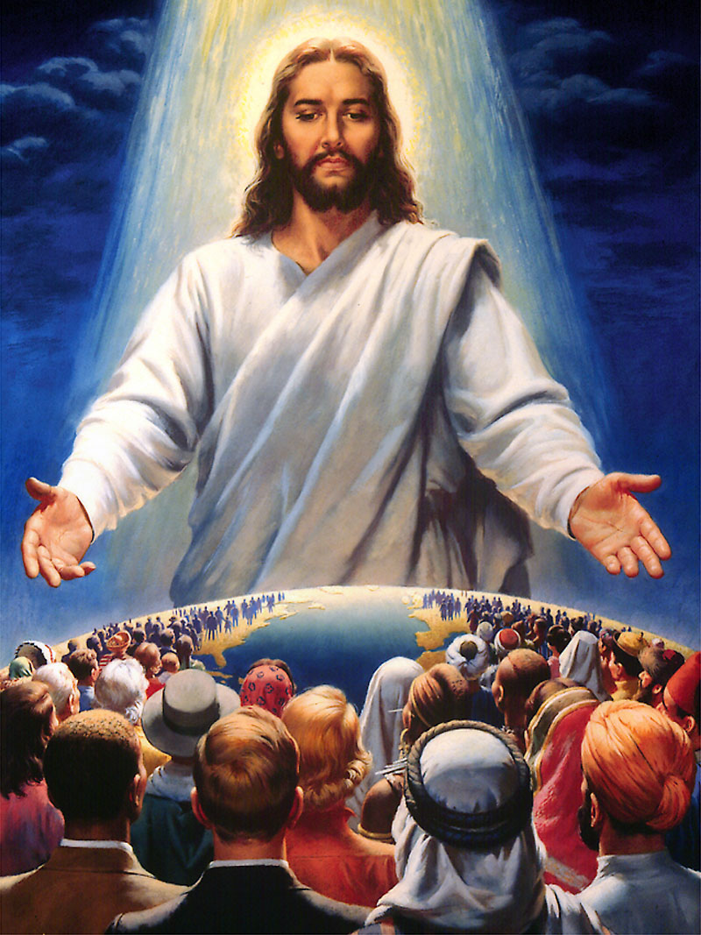
God
needs your
Participation

Slide 111
God bless

Slide 113
1:

Slide 114
1:

Slide 115
1:

Slide 116
1:

Slide 117
1:

Slide 118
1:

Slide 119
1:

Slide 120
1:

Slide 122
Revelation 18:1
“And after these things I saw another angel come down from heaven, having great power; and the earth was lightened with his glory.”

Slide 123
“The press is an instrumentality by which many are reached whom it would be impossible to reach by ministerial effort.
Christian Service p. 147.2

Slide 124
Our publishing work was established by the direction of God and under His special supervision
Testimonies, vol. 7, p. 138.

Slide 125
God set the book in the lampstand /church in order for her to shine

Slide 126
Dan Martell said,
“Books are the most powerful weapons in the World.”
“It changes lives”
https://www.danmartell.com/booksarepowerful/

Slide 128
The church must give
her attention to the
canvassing work. This
is one way in which she is to shine
in the world. Then will she go forth
“fair as the moon, clear as the sun,
and terrible as an army with banners.” Manuscript 113, 1901.

Slide 131
When we follow plans of the Lord's devising "we are laborers together with God." Whatever our position--whether presidents of conferences, ministers, teachers, students, or lay members we are

Slide 132
held accountable by the Lord for making the most of our opportunities to enlighten those in need of present truth and one of the principal agencies He has ordained for our use is the printed page.

Slide 133
In our schools and sanitariums, in our home churches, we must learn to make a wise use of this precious agency. 9T 86, 87

Slide 135
SOTERIOLOGICAL & ESCHATOLOGICAL FOUNDATION OF LITERATURE MINISTRY

Slide 136
1 Timothy 2:4 KJV
“Who will have all men to be saved, and to come unto the knowledge of the truth.”

Slide 137

“And I saw another angel fly in the midst of heaven, having the everlasting gospel to preach unto them that dwell on the earth, and to every nation, and kindred and tongue, and people.”
Revelation 14:6

Slide 138
God’s Method to Accomplish the Mission
At this writing nearly twenty thousand colporteurs are in service throughout the world, but this number is far from adequate to meet the need. God calls for message-filled books, magazines,

Slide 139
and tracts to be scattered everywhere like the leaves of autumn. As church members unite with literature evangelists in spreading the good news, the task will be accomplished. PM 5.2

Slide 140
When we follow plans of the Lord's devising "we are laborers together with God." Whatever our position--whether presidents of conferences, ministers, teachers, students, or lay members we are held
accountable by the Lord for making the most of our opportunities to enlighten those in need of present truth

Slide 141
and one of the principal agencies He has ordained for our use is the printed page. In our schools and
sanitariums, in our home churches, we must learn to make a wise use of this precious agency. 9T 86, 87

Slide 142
- presidents of conferences
- ministers
- teachers
- students
- lay members
Whatever Our Position Whether
we are held accountable by the Lord for making the most of our opportunities to enlighten those in need of present truth

